Slide 1



Flow Cytometry Workshop: Principles and Methods
Biochemical Phramacology │ Flow Cytometry Lab
IOCB Prague, October 7, 2017
Presented by:
Scientists from IOCB
Experts from BD Biosciences
Sponsored by:

Slide 2
Program:
Times Sessions
9:00 - 9:10 Registration
9:10 - 9:20 Welcome Introduction
9:20 - 10:30 Basics of Flow Cytometry
11:00 - 12:00 Fluorophores and Compensations: Fundamental Principles
Trends in Fluorescent dyes
13:00 – 14:30 Experiment planning (Panel- and experiment design including controls)
Applications – part I
15:00 – 16:30 Applications – part II
10:30 – 11:00 Coffee break
12:00 – 13:00 Lunch
14:30 – 15:00 Coffee break

Slide 3
Biochemical Pharmacology: Flow Cytometry Laboratory
Services
The Flow Cytometry Laboratory provides the art of instrumentation and resources for fluorescent analysis of cells at the single cell level (BD LSR Fortessa), including high-speed fluorescence activated cell sorting (BD FACSAria IIu).
Our goal is to provide expertise in flow cytometry areas of experimental design, instrument knowledge and training, data analysis and cell sorting.

Slide 4
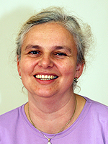


Biochemical Pharmacology: Flow Cytometry Laboratory
People
Jana Gϋnterová
Flow Cytometry Operator
BD LSR Fortessa
jana.gunterova@uochb.cas.cz
Miroslav Hájek
Experiment design, Consultancy
Miroslav.hajek@uochb.cas.cz
Alena Keprová
Training new users, Consultancy
Flow Cytometry Operator
BD, LSR Fortessa, BD FACS AriaII
alena.keprova@uochb.cas.cz
Any questions? Email us at cytometry@uochb.cas.cz

Slide 5
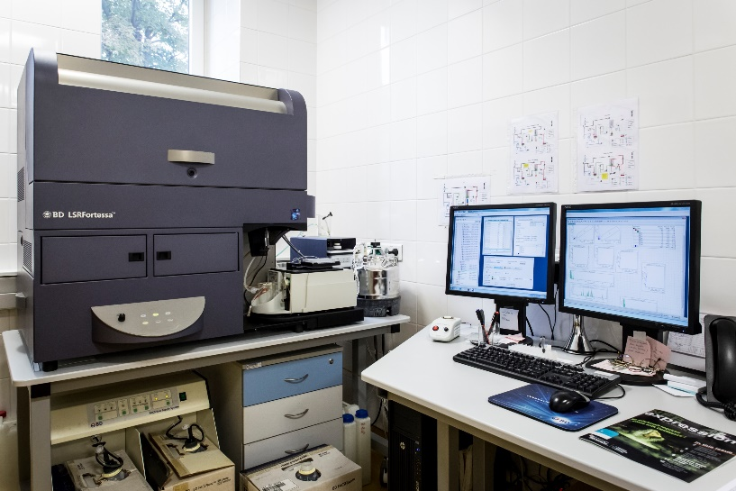
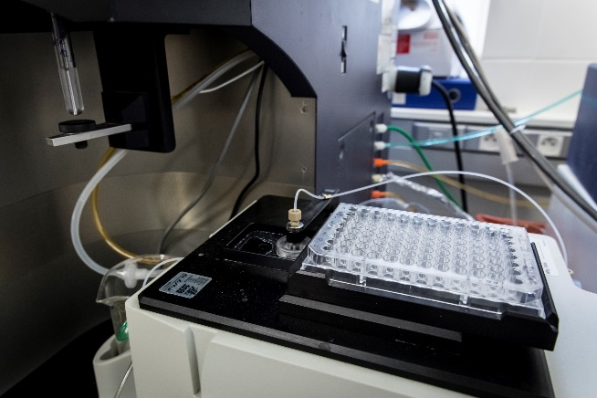
Instruments
Analyzer:
BD LSRFortessa:
5 lasers: UV (355 nm), violet (405 nm), blue (488 nm), yellow-green (561 nm), red (633 nm)
20 detector analyzer capable of measuring 18 colors simultaneously
High throughput 96-well autosampler (HTS)
Acquisition workstation – PC with BD FACS Diva 8.0
Location: C 1.32

Slide 7
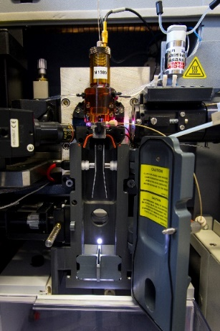
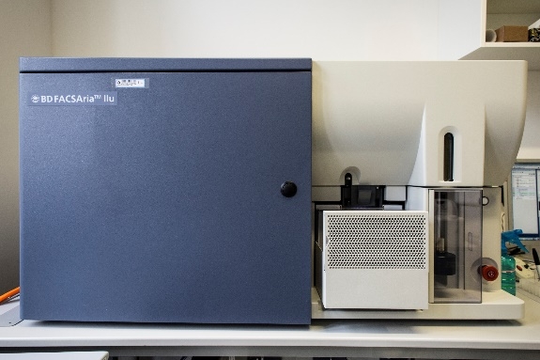
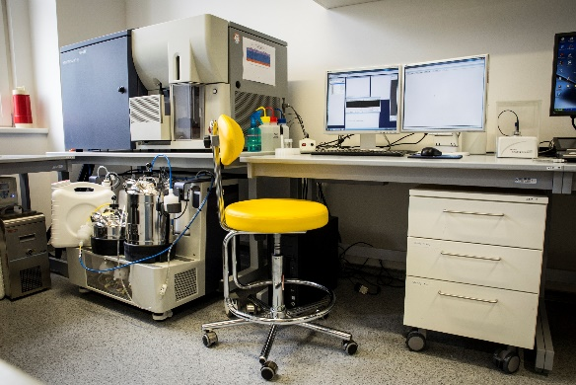
Instruments
Cell sorter (FACS)
BD FACSAria II:
3 lasers: violet (405 nm), blue (488 nm), red (633 nm)
11 detector analyzer capable of measuring 9 colors simultaneously
Cells can be brought in: 15 ml Falcon, 5 ml FACS tubes, 1.5 ml Eppendorfs
Collection device: falcons (2-way sort), tubes and Eppendorfs (4-way sort), slides, well-plates
Temperature control, nozzles: 70, 85 and 100 µm
Location: A 2.29

Slide 9
Biochemical Pharmacology │ Flow Cytometry Laboratory
Basic principles of Flow Cytometry
Topics Covered:
What is Flow Cytometry?
History of Flow Cytometry
Which particles can be analyzed?
What is measured? (FSC, SSC? Relative intensity of fluorescence)
Instrumentation: Fluidic system
Optical system
Electronic system
Data visualization, Plots and gating strategies

Slide 10
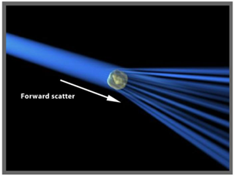
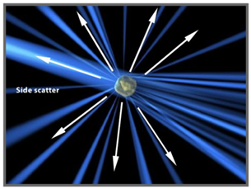
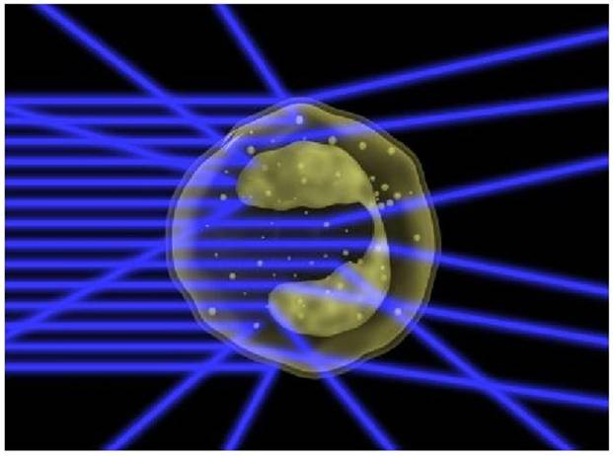
Basic principles of Flow Cytometry
Definition:
analysis of the physical properties of single cells or other biological particles
single particle passes through a flow cell → particle is iluminated by laser source →
→ detection and analysis of scattered / emitted light
This information can be used to individually sort or separate subpopulations of cells.
Measurable parameters:
Relative size (FSC)
Relative internal complexity (SSC)
Relative fluorescence intensity (FL)

Slide 11
Basic principles of Flow Cytometry
Historical Perspective: Evolution of Flow Cytometry
Counting of RBCs by Moldavan by forcing a suspension of cells through capillary tube.
Optical counting of RBCs by Crosland-Taylor by use of laminar flow principles
Development of electrostatic inject droplet deflection by Richard Sweet
Development of light microscope by Leeuwenhoek
Development of FACS and other advances
17th Century
1879
1934
1947 to 1949
1953
1965
1968
1970s onwards
The first apparatus for detecting bacteria in a LAMINAR SHEATH steam of air
Application of Sweet's principle and Coulter principle to develop the first cell sorter by M. Fulwyler
Development of fluorescence based cell sorter by Wolfgang Gohde
Principles of Droplet formation by Lord Rayleigh

Slide 12
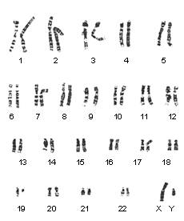
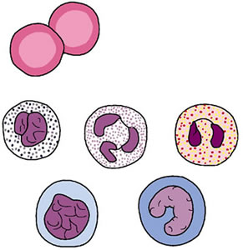
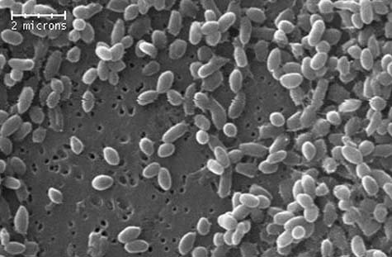
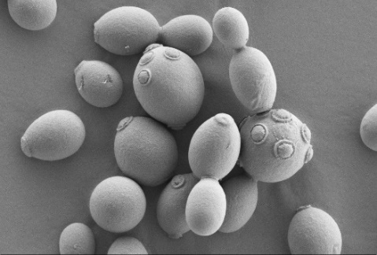
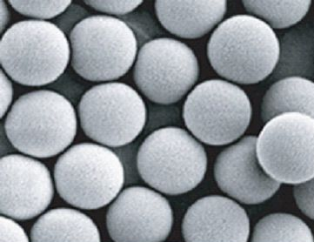
Basic principles of Flow Cytometry
What type of particles can be analyzed in cytometer?
Cells
Chromosomes
Bacteria
Yeast
Microparticles (beads)
Microvesicles
Nanopartcles?

Slide 13
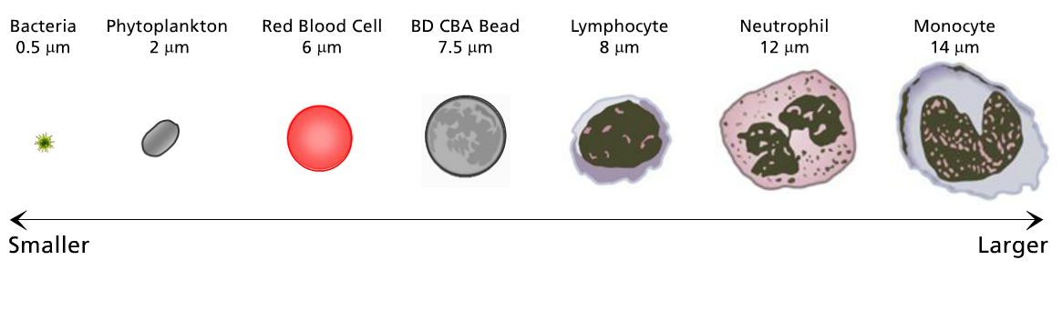
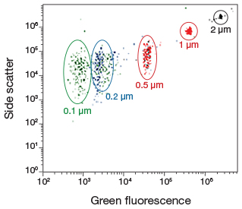
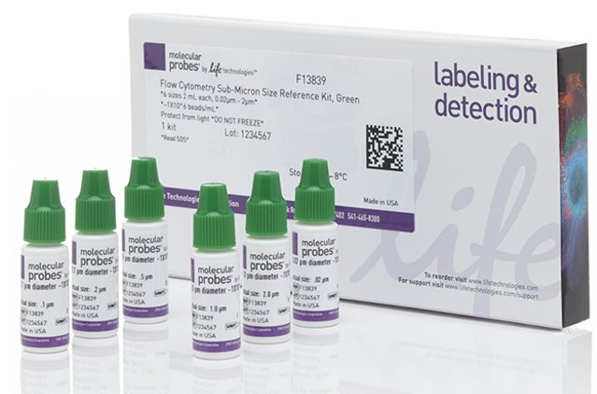
Basic principles of Flow Cytometry
What particle sizes can be analyzed?

Slide 14
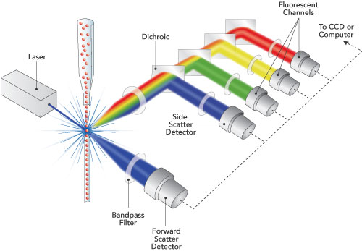
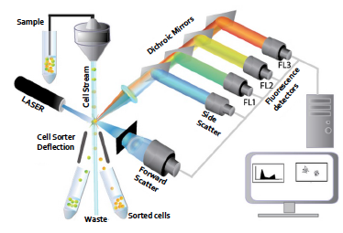
Instrument overview
Where are samples run?
Flow cytometry integrates fluidic, optics, and electronics.

Slide 15
Instrumentation
1. Fluidic System
What is sheat fluid?
Sheath flow is the solution that runs in a flow cytometer
Depending on experimental needs, different formulations of sheath fluid can be used
The purpose of FLUIDICS SYSTEM is to transport sample to laser intercept!
"After the intercept, the cells either flow into the waste or, in the case of a cell sorter, the stream is broken into droplets, and the appropriate droplet is charged and sorted."

Slide 16
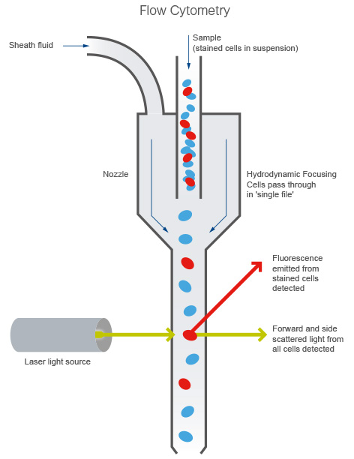
Fluidic System
The sample is introduced into the running sheath fluid in the FLOW CELL
Sample is hydrodynamically focused in the core stream
Sheath fluid and sample do not mix
Diameter of Flow Cell determines size of largest particle to pass (smallest part in analyzers)
Reduction of cross-section causes laminar fluidics
Sample flow rate adjustable

Slide 17
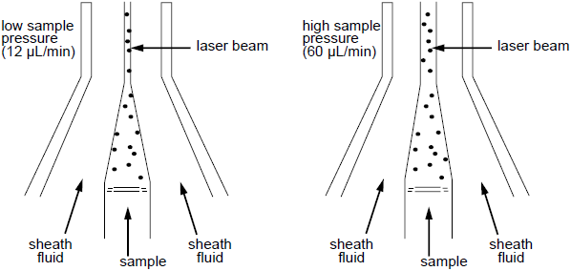
Instrumentation
What happens when we increase the flow rate?
And what are the consequences of this?
The pressure of the sheath remains the same.
Pressure of sample line will increase.
Core stream of cells will become wider.
Not optimally aligned with the laser at high flow rates!
It is better to have concentrated samples at low flow rate than diluted sample at high flow rate (higher precision)

Slide 18
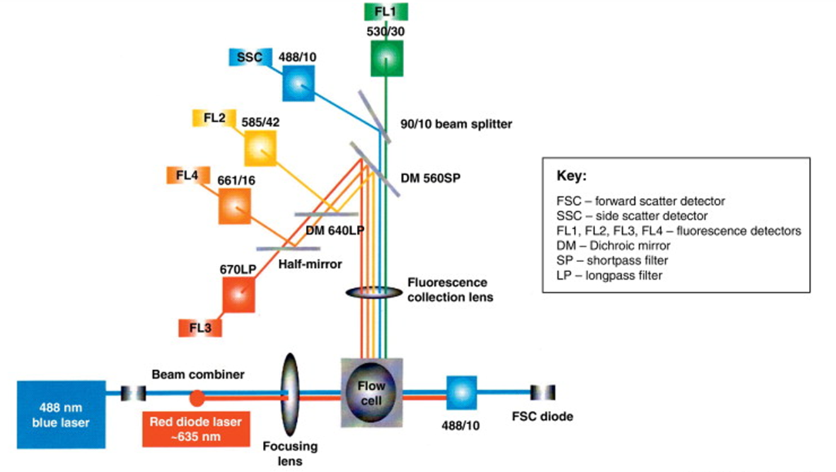
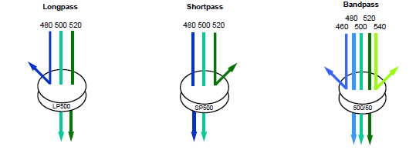
Instrumentation
2. Optical System
Optics System allows the excitation and emission of the emitted light
(components involved in fluorescent detection)
Laser excitation optics x collection optics

Slide 19
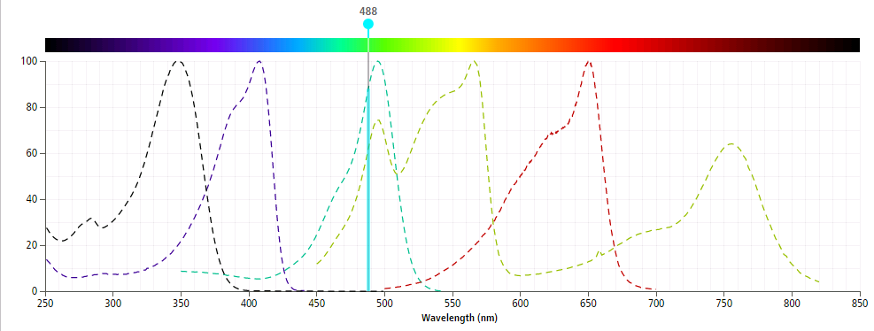
Laser as excitation source!
Optical System
Different lasers are used to optimally excite fluorochromes.
This guarantees that the potential of the fluorochrome is optimally exploited.
BV421
PE-Cy7
FITC
BUV395
APC

Slide 20
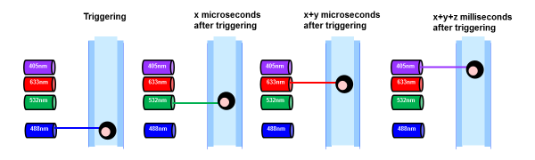
But how does the flow cytometer know that it is the same cell passing the different laser?
Laser delay time
The stream is a constant flow with a constant velocity.
This allows to estimate the laser delay time:
  How long does it take to reach the second, third and fourth laser from the first laser?
Based on the laser delay the software will combine the measured signals to one event (cell)

Slide 21
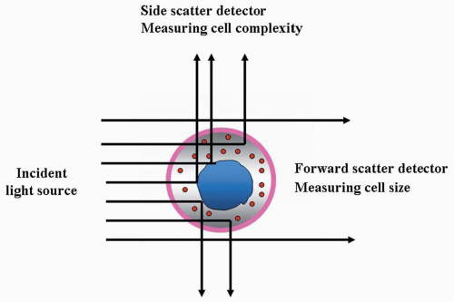
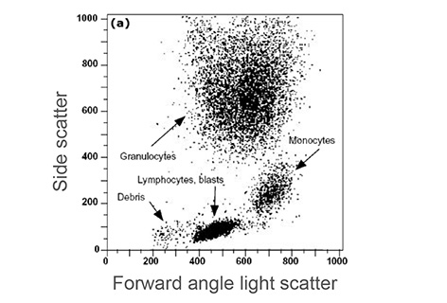
Generation of light scatter

Slide 22
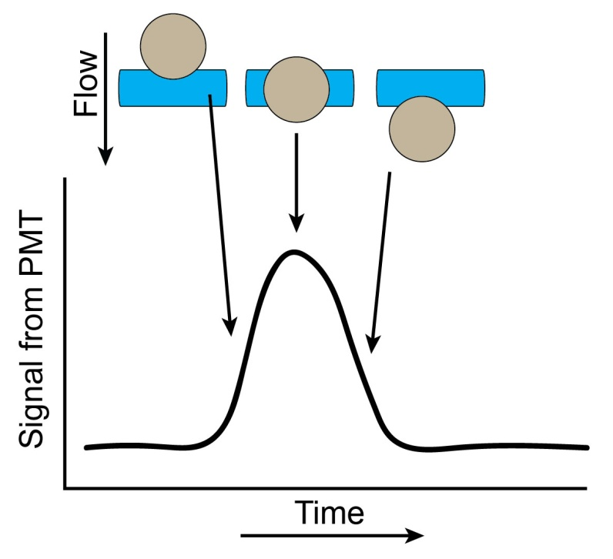
Optical System
Forward scatter channel
the relative size (FSC)
Forward scatter detector
Coherent light source (488 nm)
Forward scatter channel:
detect the amount of light scattered in the forward direction
(along the same axis that the laser light is traveling)
particle passes through the focus
→ scattered light is detected by a photodetector
→ an electrical pulse is generated
presented to the signal processing electronics

Slide 23
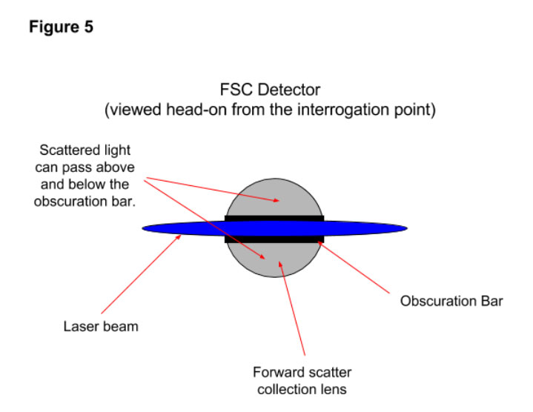
Optical System
Forward scatter detector
The forward scatter obscuration bar interacts with laser light
Many cytometers use optical fibers to direct collected light to the fluorescence and side scatter detection system. In these types of systems, the output of the collection lens is focused on the ends of fibers, which are routed to the detection path. This can be very advantageous in overall cytometer design.

Slide 24
Optical System
Intensity of forward scatter:
is most influenced by size of particle

Slide 25
Optical System
Forward scatter channel
the relative size (FSC)
Forward scatter detector
Coherent light source (488 nm)
Forward scatter channel:
detect the amount of light scattered in the forward direction
(along the same axis that the laser light is traveling)
particle passes through the focus
→ scattered light is detected by a photodetector
→ an electrical pulse is generated
presented to the signal processing electronics

Slide 26
Optical System
Side scatter channel (SSC):
detect the amount of light scattered to the side
(90° to the axis that the laser light is traveling)
intensity of SSC is most influenced by the shape and optical homogeneity of cells

Slide 27
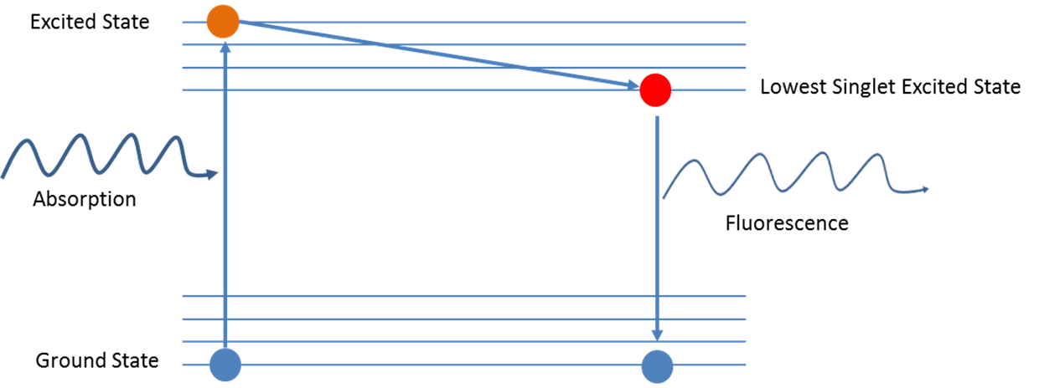
Optical System
Using a fluorescence in Flow Cytometry
What is Fluorescence light?
or cells
transfected with fluorescent proteins
The fluorochrome absobs energy from the laser and releases the absorbed energy by:
Vibration and heat dissipation
b) Emission of photons of a longer wavelength =====> FLUORESCENCE
Stokes shift: energy difference between the wavelength of absorption and emission

Slide 28
Optical System
Fluorescence detection:
Fluorescence emitted by each fluorochrome is usually detected in a unique fluorescence channel.
Fluorescence detector
(PMT3, PMT4 etc.)
SSC detector photo multiplier tube (PMT)
FCS detector photo diode
(signal levels are high)
Specificity controlled by the wavelength selectivity of optical filters and mirrors.

Slide 29
From Fluorescence to Computer Display
Data Analysis
Each cell generates a quanta of fluorescence.
Individual cell fluorescence quanta is picked up by the various detectors PMT ' s (photomultiplier tubes).
PMT's convert light into electrical signals (pulses).
These electrical signals are amplified and digitized using Analog to Digital Converters (ADC's).
Each event is designated a channel number (based on the fluorescence intensity as originally detected by the PMT's) on a 1 - Parameter Histogram or 2 - Parameter Histogram.
All events are individually correlated for all the parameters collected.
Flow cytometric data is stored in FCS format, developed by the Society for Analytical Cytology.

Slide 30
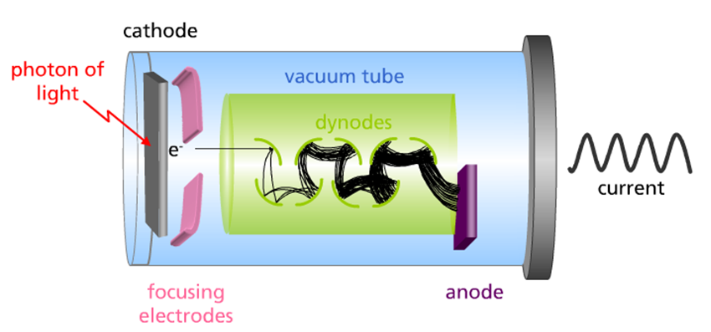
3. Electronics
Data Analysis
Photomultiplier Tube (PMT) → PMTs convert light into electrical signals
The photodiode detectors or photo- multipler tubes first collect the light signal from the cells. The photons produce a pulse of electrical current.
Photomultiplier tubes have a voltage applied across a series of plates.
This increases their sensitivity so that fewer photons are required to produce an electrical current.
The initial small current requires amplification. The amplified current ranges from 0 to 10 V depending on the strength of the signal.

Slide 31
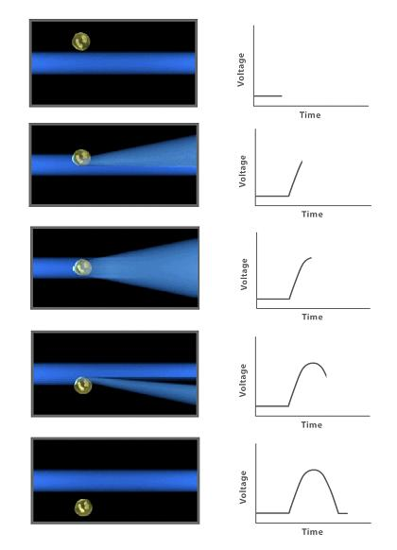
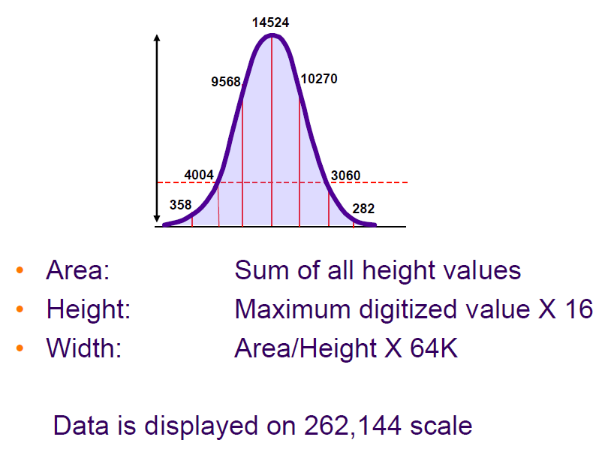
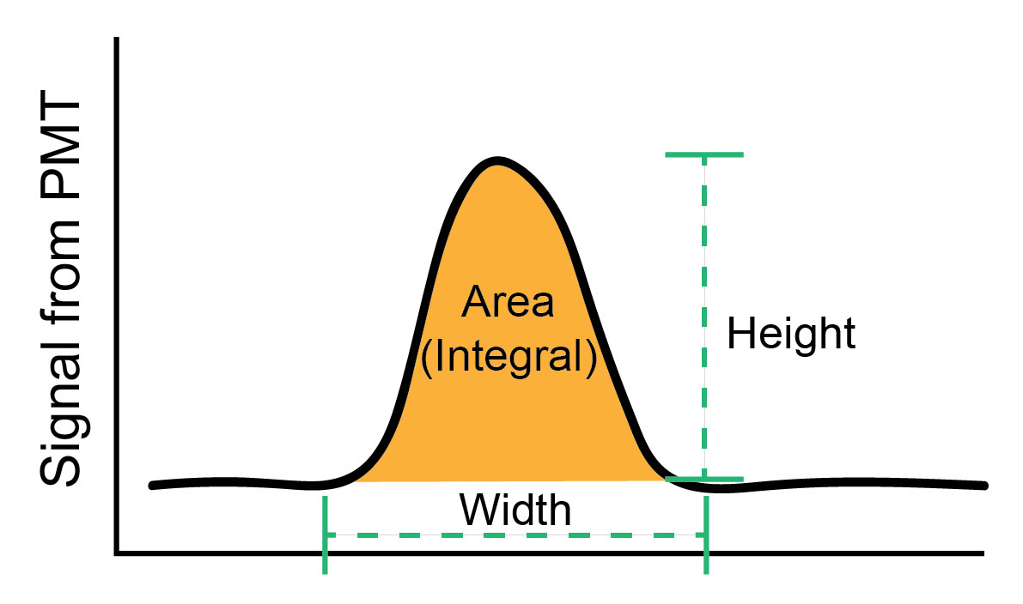
Data Analysis
A cell passes the laser interogation point and a signal is recorded…
Voltage Pulse of one cell:
Characteristics of the voltage pulse.

Slide 32
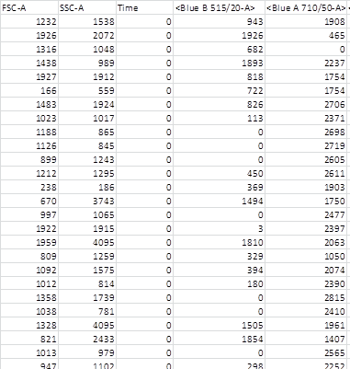
How the voltage pulse signals are stored
Data Analysis
From every cell the maximum height (H) value every` signal, as well as the width (W) of the signal, as well as the area (A) of the signal is stored along with the time parameter.

Slide 33
How histograms are created
Data Analysis

Slide 34
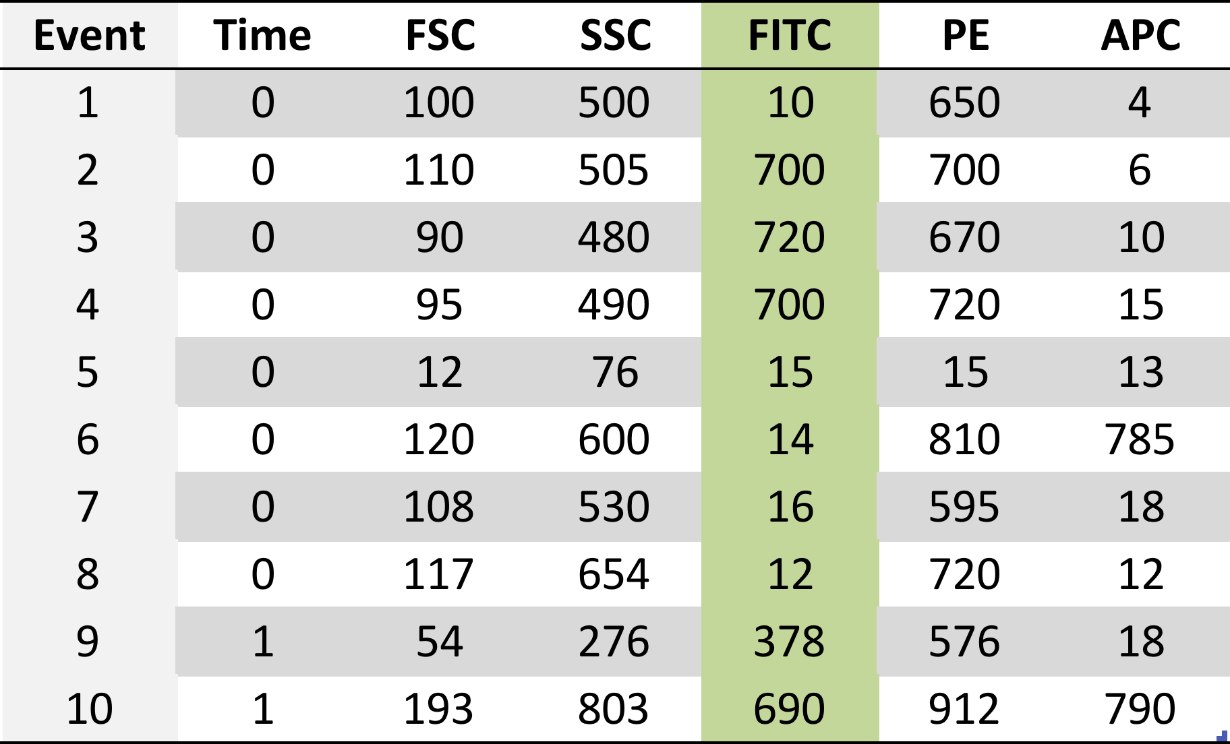
Summary
1. Emission
2. Detection
3. Converted to voltages
4. Measured
5. File generated
6. Plotted

Slide 35
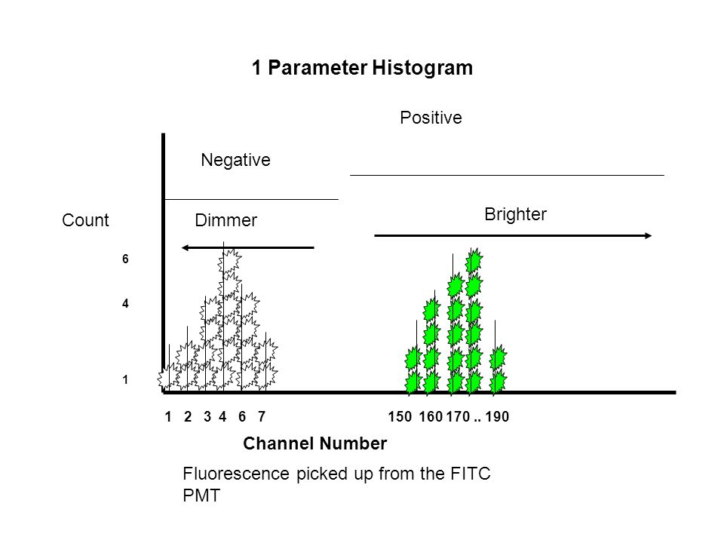
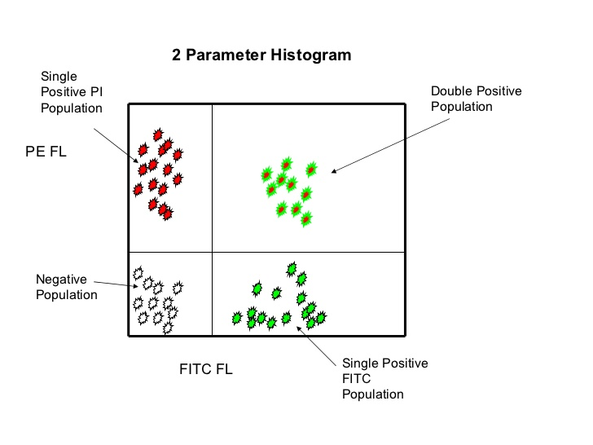
Data Analysis
Once a data file has been saved, cell population can be displayed as:
Dot plots:
1-Parameter Dot Plots vs. 2-Parameter Dot Plots
  Limitations: No density information (how many cells in a given range)

Slide 36
Data Analysis
Fluorescence one color histogram:
in conjunction with fluorescence-based protein reporters (GFP)
-> monitor both transfection efficiency and protein expression levels.

Slide 37
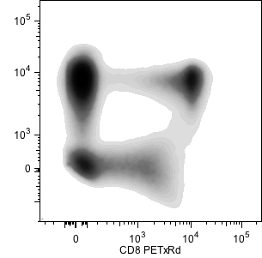
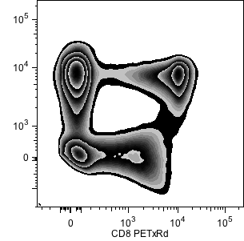
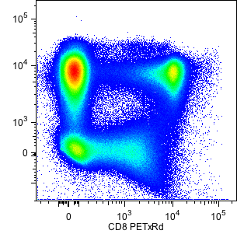
Data Analysis
Density plots:
Provides the density of events in a given region
Three common ways to plot
Density
Zebra
Pseudocolor

Slide 38
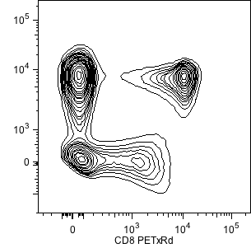
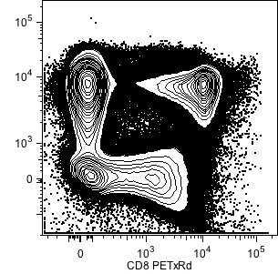
Contour Plots
Data Analysis
Each contour contains progressively less data
    First contour typically top 95% of data
Can mask actual amount of data
Don’t show outliers well / Use contour plot with outliers

Slide 39
Data Analysis
Data generated in flow cytometry is displayed using Multiparameter Acquisition and Display software platforms.
Histograms corresponding to each of the parameters of interest can be analyzed using statistical tools to calculate percentage of cells manifesting specific fluorescence, and fluorescence intensity.
This information can be used to look at fluorescence expression within subpopulations of cells in a sample (GATING).
REGIONS and GATING …

Slide 40
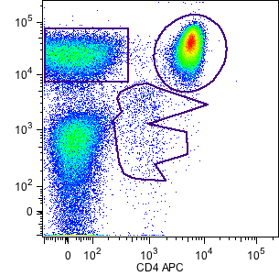
Data Analysis/Gating and Statistics
REGIONS
A region is a numerical or graphical boundary that is used to define the characteristics of particles to include for further analysis.
Drawing regions is often subjective, unless proper controls are used!
    Critical Controls:
      FMO control
      Biological Controls
        Stimulated samples
        Reference controls
Type of regions and how to place them:
Rectangular, Circles/ellipses, Polygon, Quadrants

Slide 41
Types of Regions and how to place them
Data Analysis
Data generated in flow cytometry is displayed using Multiparameter Acquisition and Display software platforms.
Histograms corresponding to each of the parameters of interest can be analyzed using statistical tools to calculate percentage of cells manifesting specific fluorescence, and fluorescence intensity.
This information can be used to look at fluorescence expression within subpopulations of cells in a sample (GATING).
REGIONS and GATING …

Slide 42
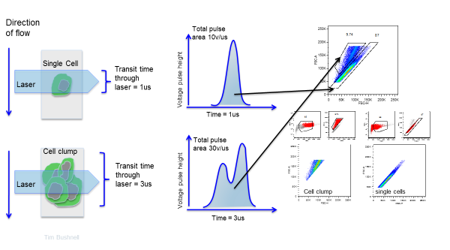
Data Analysis/Gating and Statistics
What gating means?
Gating uses regions to allow subsets of data to pass through to a downstream plot.
Gating is a data reduction method. Gate carefully!
Gating example:
Doublet exclusion

