Slide 1
Experiment Design and Controls
General consideration – Good science!
Consider particles of interest and their inherent characteristics (Bacteria, lymphocytes, cell lines, organelles)
Cell preparation and potential pitfalls (Mild vs. harsh procedures, trypsinizing vs. ex vivo preparations)
Marker selection (Critical, well-known, speculative and additional helpful markers)
Biological controls
Goal: Biologically meaningful results

Slide 2
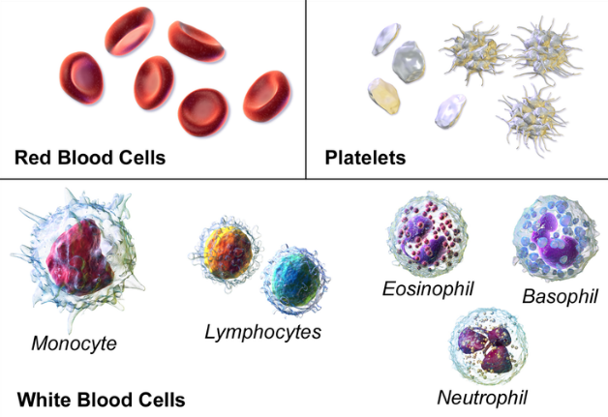
Experiment Design and Controls
Sample preparation:
Cell preparation ex vivo can affect quality of samples significantly
Harsh procedures can kill cells and/or damage displayed markers
Harshness Scale: Trypsin > Collagenase A > Dispase > Liberase > Collagenase D
Needs to be tested empirically for specific organs and markers of interest
Blood cells
Bacteria
Organells
Cell lines
Extracted cells from tissue (often harsh procedures required)
Whatever protocol you are using… You should end up with a single cell suspension !

Slide 3
Experiment Design and Controls
Optimizing your experiment: Flow cytometry consideration
Reagent optimization (titration) → Background and financial considerations
Doublet and dead cell exclusion → Measuring of live, single cells
Signal amplification → Setting the correct PMT voltage
Choice of fluorochromes & spectral overlap → Compensation
Controls in flow cytometry → Which controls are needed?
Goal: Best possible results

Slide 4
Optimizing your experiment
1. Reagent use & antibody titration
Goal: best possible separation between positive and negative signals
What are the fluorescent markers in my sample?
Intrinsic fluorescent markers (e.g. transgenic GFP mice)
Extrinsic = staining ➔ majority of flow cytometry experiments
Signal intensity of extrinsic markers depends on:
Marker expression level (cannot be influenced)
Quality of the antibody (hard to influence)
Optimal reagent concentration → influence by titration

Slide 5
Optimizing your experiment
1. Antibody titration basics
maximize signal:noise (pos/neg separation) - this may occur at less then saturated staining
- this may or may not be the manufacturer‘s recommended titer
concentration too low → positive signal decreases
concentration too high → background increases
optimal concentration = minimal antibody concentration yielding maximum signal separation
Protocol: prepare the dilution series (4-8) → stain your cells according to your standard protocol → analyze the cells on flow cytometer → export data and analyze in software of choice → calculate the stain index
Stain Index:
Alternative equation for Stain Index:
$$SI= \frac{{Med}_{pos} −{Med}_{neg}}{[\left({84\%}_{neg}−{Med}_{neg}\right)/0.995]}$$
$$SI= \frac{{Med}_{pos }− {Med}_{neg}}{{2 x SD}_{neg}}$$

Slide 6
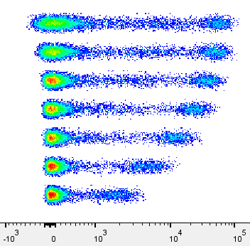
Optimizing your experiment
1. Reagent use & antibody titration
Decreasing concentration decreases SI because of decreased positive staining
1:50
Increasing concentration decreases SI because of increasing background
1:100
1:200
Concentration of Ab
1:400
Optimal staining
range
1:800
1:1200
1:1600
CD8 - PerCP-Cy5.5
Concentration of Ab
Consider:
clone, affinity, monoclonal vs. polyclonal, Ig-Isotype, type of Fluorochrome, concentration

Slide 7
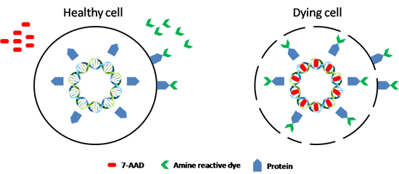
Optimizing your experiment
2. Dead cell exclusion
Problem: Dead cells, with compromised membrane integrity, tend to be sticky ➔ bind all sorts of reagents unspecifically ➔ false positives ➔ exclude dead cells from analysis
Solution: Exclude dead cells with live-dead marker
I. DNA intercalators
Propidium iodide (PI)
7-Aminoactinomycin D (7-AAD)
DAPI
II. Amine-reactive dyes
different emission types availiable e.g. Zombie Aqua/Yellow/NIR
These dyes can be fixed after staining!
L/D marker working principle

Slide 8
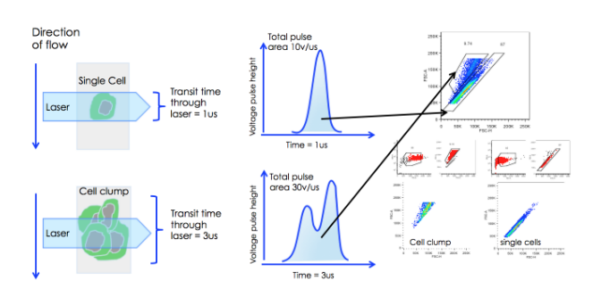
Optimizing your experiment
3. Doublet exclusion
Goal: measuring single cells
Easy exclusion by exploiting relationship between signal height, area and width of the FSC and SSC
Tim Bushell

Slide 9
Optimizing your experiment
4. Optimizing Photon Multiplier Tube Voltages (PMTVs)
Goal: observe all events on scale → quantifiable data
PMT voltages affect signal amplification
FSC & SSC PMTVs:
can be adjusted to suit your preferences/cells
ensure that all relevant events are observed on the scatter plot
Fluorescent parameter PMTVs:
Ensure that positive and negative populations are on scale
Modern cytometers offer preset values which were optimized during quality control (dim, medium & bright beads)
Do not change PMTVs after recording compensation controls
PMTV settings based on unstained cells only necessary for „old“ analog cytometers (FACSCalibur) NOT a valid approach for modern digital devices!

Slide 10
Optimizing your experiment
4. Optimizing Photon Multiplier Tube Voltages (PMTVs)
Goal: observe all events on scale → quantifiable data
↓ FL-1 PMTVs
FL-1
FL-1
Avoid off scale populations
SSC-A
FCS-A

Slide 11
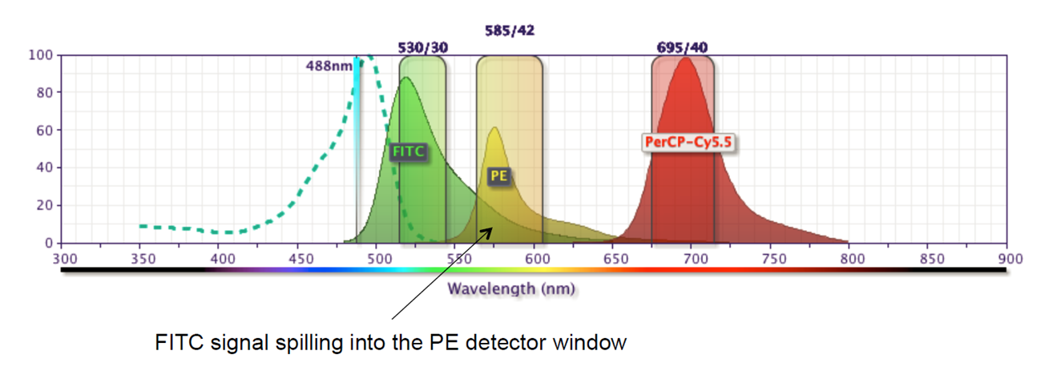
Optimizing your experiment
5. Fluorochrome choice & Compensations
Goal: brightest signals, smallest spectral overlap
Appropriate choice of fluorochromes to minimize spectral overlap
Where unavoidable, spectral overlap requires compensation (most fluorochromes have broad emission spectra)

Slide 12
Optimizing your experiment
5. Fluorochrome choice & Compensations
Goal: brightest signals, smallest spectral overlap
process of correcting spectral overlap is a mathematical operation called compensation → calculated automatically by wizard in Diva software
required: single-stained controls for each fluorochrome used in an experiment
usually compensation values are listed in percent e.g. „PE -10% FITC“ " means that 10% of FITC signal (donor) are detected in the PE detector (receiving channel)!
compensation value depends on:
cytometer set-up (mirrors, filters, lasers)
fluorophore properties (Alexa-488 vs. FITC)
voltage of a given PMT → Set PMT voltages before recording single stains!
Note: PMTs detects photons regardless from which fluorochrome they originate

Slide 13
Optimizing your experiment
6. Controls in Flow Cytometry
Goal: correctly compensated/gated specific data
Controls must undergo the same treatment (i.e., preparation, fixation) as all the tubes in an experiment.
Prior acquisition
Compensation → Single-stained controls
Gating controls → fluorescence minus one (FMO) controls Where does negative end and positive begin?
Specificity controls → isotype controls
Post acquisition
Quality control of your acquired data Stability of flow during measurement!

Slide 14
Optimizing your experiment
Controls: a) Specificity controls
Unstained controls: - to detect the autofluorescence* or background staining - to set up PMT-voltage for FSC, SSC and FL-channels
*Autofluorescence: - fluorescent signals generated by the cells themselves (from pyridine and flavin nucleotides) - present in all cells (viable and dead) - adds to fluorescence label of cells > decreases fluorescence detection limit - observed in all fluorescence channels, but decreases dramatically at longer wavelengths (>600 nm, far-red/infra-red)
Solution: for cell types with high autofluorescence, a dye with a longer emission wavelength (APC, APC-Cy7) often provides excellent signal-to-noise ratio
Secondary controls: - for indirect staining - secondary Ab alone to control for non-specific binding of this polyclonal Ab to dead or sticky cells

Slide 15
Optimizing your experiments
Controls: a) Specificity controls
Specificity (experimental and gating) controls
e.g. transfected cells: transfected / mock transfected / wt cell line
primary cells: WT / KO or activated / naive
Isotype controls:
not necessary for (lineage) markers with clearly separated population
Ab with the same Ig isotype as the test Ab, specificity known to be irrelevant to the analyzed sample
Use commercially available isotype control of unknown specificity or choose suitable antibody which recognizes an antigen that presumably is not present on the cells of interest
Control for nonspecific staining of an antibody of a particular isotype conjugated to a particular fluorochrome
Suitable for identifying the problem, but not to quantify it → do not gate based on unspecific staining!

Slide 16
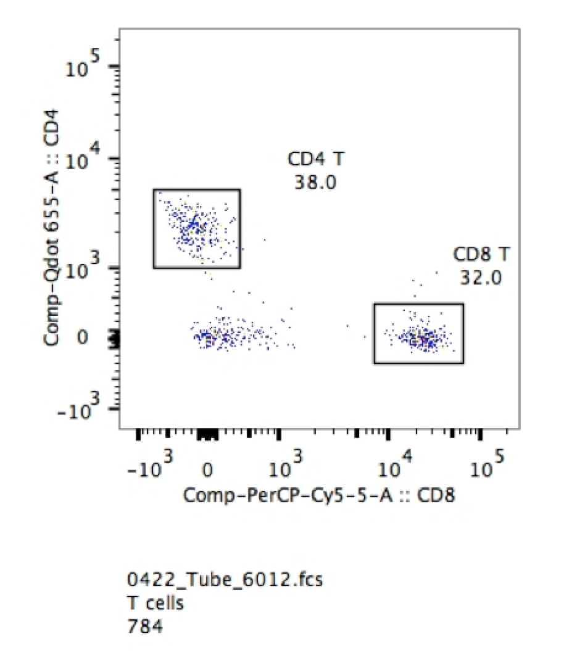
Optimizing your experiments
Tip for not using isotype controls:
You certainly do not need them for things that are clearly bimodal
If you are looking for T cells and B cells in peripheral blood..

Slide 17
Experiment Design and Controls
Controls:
b) Single stained-controls
Goal: high quality single-stained controls
Positive and negative population must have the same autofluorescence, i.e. should be of the same kind
Same fluorochromes as in your experiment must be used Especially important for tandem-dyes (Lot, manufacturer, etc.)!
Single-stained control should be at least as bright or brighter than experimental staining → compensation beads
Compensation controls should be treated the same way as samples (fixation, incubation time, etc.)

Slide 18
Experiment Design and Controls
Controls:
b) Single stained-controls
Antibody capture beads as single stain controls:
saves sample
more precise computation of the spillover (beads have smaller signal CV)
useful for parameters that are too dim in the experimental setting i.e. cytokines, chemokines,…
Note: Some beads are isotype specific! (Ultracomp beads by Ebiosciences are versatile)
Cells as single stained-controls:
work for ALL reagents (PI, DAPI,…)
the control is, ideally, as bright as the experimental sample (not necessarily true)
You can combine cells and beads for single-stained controls! → use a controls containing unstained & stained cells or unstained & stained beads, respectively, to provide the correct negative population for the calculation

Slide 19
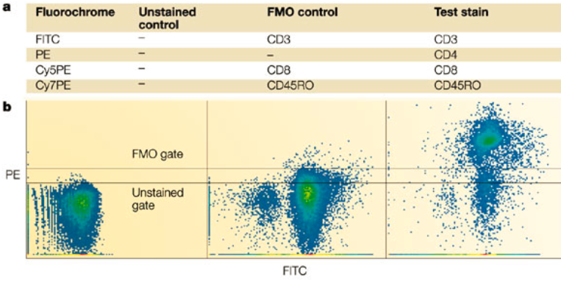
Experiment Design and Controls
Controls:
c) Fluorescence Minus One (FMO) controls
Control which is used to identify and gate cells in the context of data spread due to the multiple fluorochromes in a given panel
An FMO control contains all the flurochromes in a panel, except for the one that is being measured
Ideally add an isotype control in place of the controlled reagent (FMO + isotype)
Good gating controls!

Slide 20
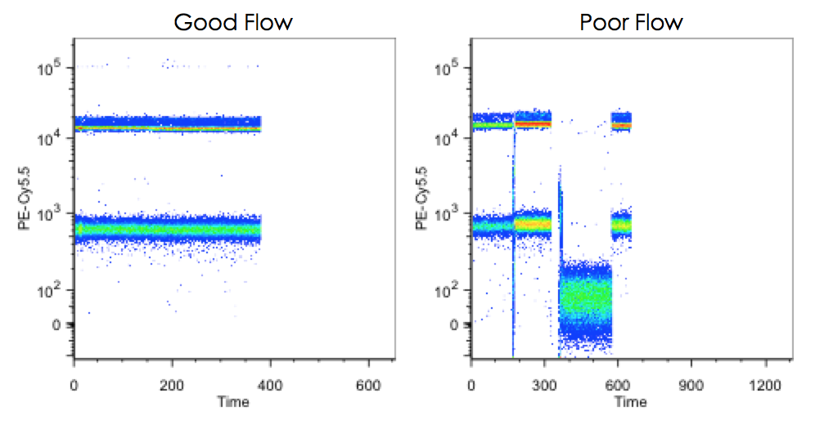
Controls in Flow Cytometry
Stability of the flow:
Quality control post aquisition:
Check stability of fluorescence signal over time for at least one fluorescence parameter/channel per laser
Flow instabilities can be caused by loading of dense samples (esp. at the start of a measurement) or partial clogs → pressure fluctuations
Always wait a few seconds for the flow
to stabilize before recording data!

Slide 21
Controls in Flow Cytometry
Stability of the flow:
"Poor flow " indicates a major issue with fluidics and if this is observed, it is time to stop and do a quick cleaning/check of the system.
Cleaning tips:
WASH on High Flow Rate: 5 min FACS Clean > 5 min FACS Rinse > 5 min H₂O
Remember, filtering samples is always a good idea!

Slide 22
Experiment design
Analytical variables to consider
Data Acquisition, Analysis and Interpretation
Instrument setup and Interpretation
use unstained control to adjust and optimize FSC & SSC PMTVs
run fully-stained sample before you record compensation controls
→ set voltages: decrease voltages for any detectors where event are off-scale increase voltages for any detectors where low-end resolution is poor
run single-stained compensation controls for each experiment and set compensation (use Diva software)
run appropriate controls: gating controls (e.g., FMO), biological controls (e.g., unstimulated controls)…
think about the speed of analysis (high flow rate → less intensity resolution)

Slide 23
Experiment design
Analytical variables to consider
Data analysis / Interpretation
record appropriate number of events to ensure reliable results, think about the gating strategy
visually inspect your data
check gating across all samples in experiment, use back gating
Avoid classification errors and false conclusions due to improper compensations and/or gating, or sample artifacts
Ask for interpreting the data, experiment and instrument setup → save time and labor

Slide 24
Some general handling tips:
If in doubt with anything: get your core staff.
You can not destroy your cytometer by inserting a sample
You can not destroy your cytometer unless you hit / kick or flood it.
Always follow SOPs (Standard Operating Procedures) if you have some.
Rule of thumb:
unplugging as well as taking in and out is ok
unscrewing (with a screw driver) is in most of the cases NOT ok.
If Rule 5.2. was unfortunately violated immediately follow handling tip number 1.

Slide 25
Experiment Design and Controls
Take home message:
Planning and quality-control pays off and saves time in the long run!
Always titrate your antibodies!
Use singlet gating and a dead cell marker!
Before you start complex experiments: test your panels!
Prepare your single-stained controls perfectly!
Include FMOs for questionable signals and consider isoptype controls esp. when working with new cells!
Quality-control your data after acquisition (time parameter)!

