Slide 1
Applications of Flow Cytometry
Miroslav Hájek
Biochemical Pharmacology
IOCB Flow Cytometry Workshop, 7th November 2017

Slide 2
Applications of Flow Cytometry
Topics Overview
Cell Cycle Analysis
Proliferation (Dye-dilution, Ki-67, EdU)
Apoptosis Detection (Annexin V, JC-1, caspases)
Immunophenotyping (Cell Surface Antigens, Markers)
Intracellular Analysis (Cytokine Staining Assay)

Slide 3
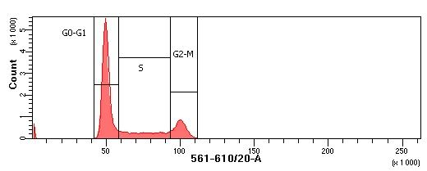
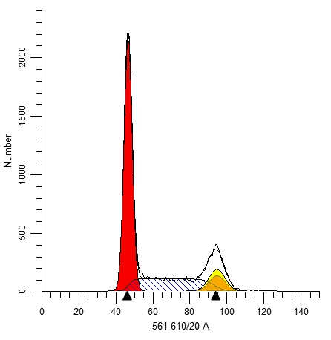
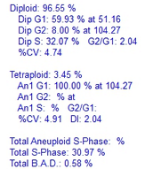
Cell Cycle Analysis
DNA Analysis: Workflow
DNA Probes: The fluorescence is proportional to the amount of DNA in the cell
G1
DNA staining
+ flow cytometric analysis
S phase
M
RAW data
G0/G1
G2
1
G₁
G₂M
1
2
DNA content
Fitting software such as ModFit LT (Verity Software House) used to quantify cell cycle distribution of proliferating cells precisely

Slide 4
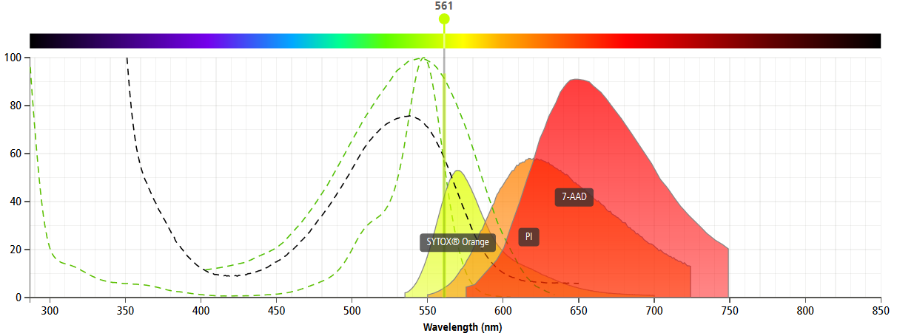
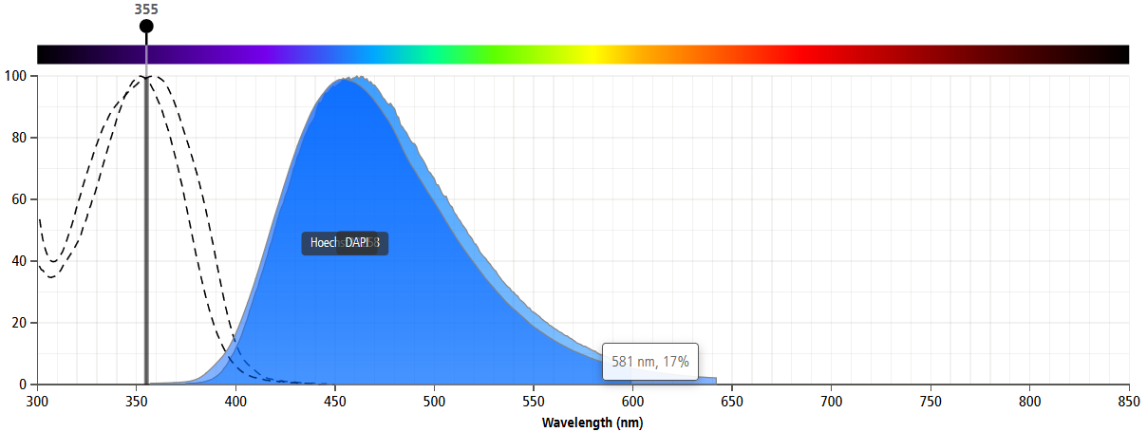
Cell Cycle Analysis
DNA-binding dyes: Stoichiometric binding to DNA allows quantitation
Cell-impermeant dyes (Dead Cell Stains)
Propidium iodide (PI)
7-Aminoactinomycin D (7-AAD)
SYTOX Stains (Blue, Green, Orange, Red)
DAPI
TO-PRO
Cell-permeant dyes (Vital Stains)
Hoechst 33342
Hoechst 33258
DRAQ5
SYTO Stains (Blue, Green, Orange, Red)
Permeant/Impermeant
DNA/DNA & RNA

Slide 5
Cell Cycle Analysis
DNA staining protocols
Cell fixation and permeabilization (ethanol) + addition of DNA fluorochrome (PI) + RNase treatment: Prolonged sample storage (several weeks at 4 °C), gives good DNA histogram profiles (low coefficient of variation, CV), cell clumping, higher cell loss, incompatible with fluorescent proteins (GFP, PE, APC, PerCP) and some surface markers
Permeabilization with detergents (Triton X-100, NP-40, saponin) + PI + RNase treatment: If not fixed with paraformaldehyde, samples have to analyzed within 1 hour after preparation; can be combined with intracellular staining
Live cell cycle analysis (Hoechst dyes, DRAQ5™, DyeCycle dyes): Some cell types can efficiently pump out the dyes, CV’s are higher

Slide 6
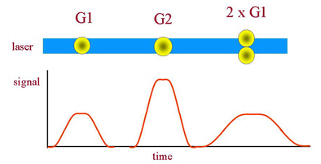
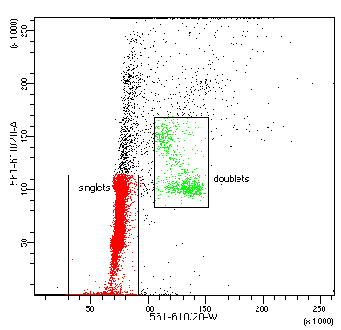
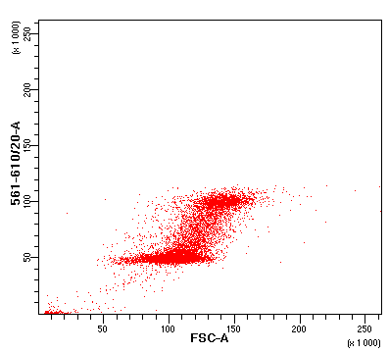
Cell Cycle Analysis
Doublet discrimination
Aggregate discrimination dotplot
- removing doublets using pulse geometry
Peak Height, Width, Area
Voltage Intensity →
http://flowbook.denovosoftware.com/chapter-6-dna-analysis
Propidium iodide - Area
G2
Propidium iodide - Area
Propidium iodide - Width
G1
FSC ∼ Cell Size

Slide 7
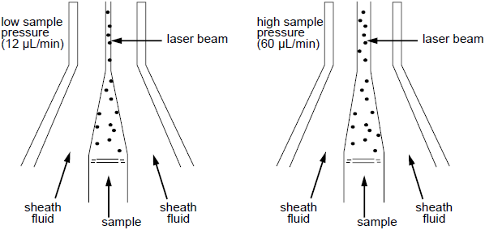
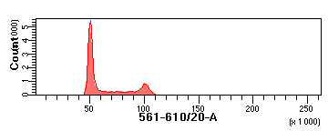
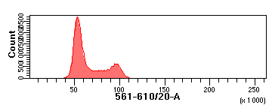
Cell Cycle Analysis
Data Analysis: Coefficient of Variance (CV)
%CV = (SD/Mean channel #) x 100
Low speed acquisition (narrow stream)/RNA removal
Lower CV’s (more tight G0/G1, G2/M peaks on histogram)
Cell cycle analysis: < 300 events/s
Less overlap between the G0/G1 and S, G2/M and S
More accurate DNA measurements
A %CV lower than 8 is considered good

Slide 8
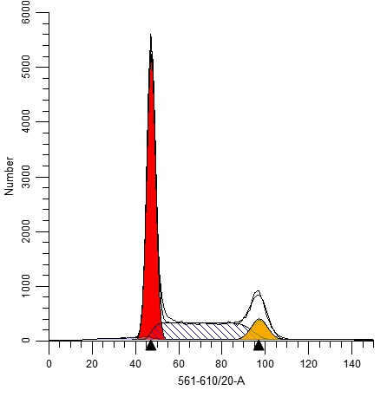
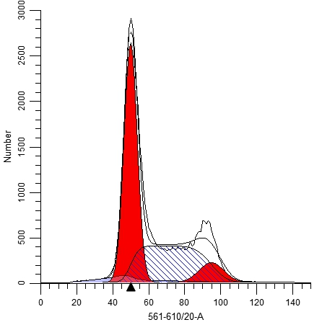
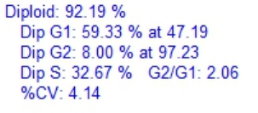
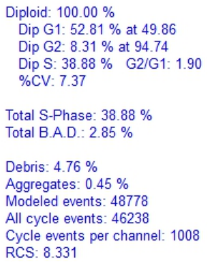
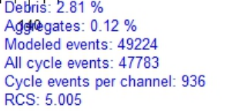
Cell Cycle Analysis
Data Analysis: Coefficient of Variance (CV)
HeLa cells, w/ RNase A treatment
HeLa cells, w/o RNase A treatment
CV = (SD/Mean channel #) x 100
Phenotype analysis: > 500 events/sec
a measure of goodness of the fit
More accurate DNA measurements

Slide 9
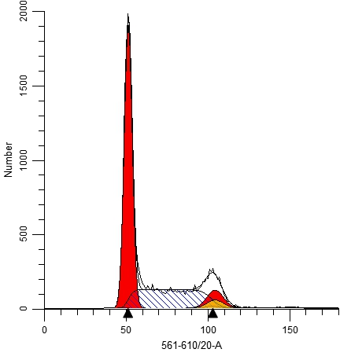
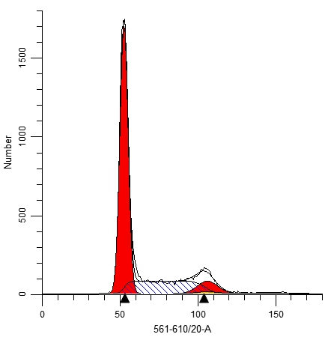
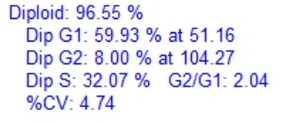
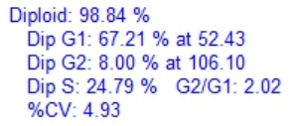
Cell Cycle Analysis
Limitations of one-parametric DNA histograms: Example 1
SH-SY6Y cells: differentiation induced by retinoic acid (ATRA)
control
+ ATRA

Slide 10
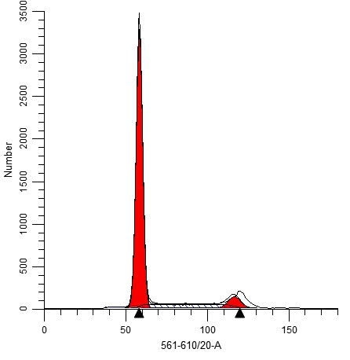
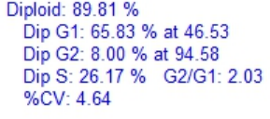
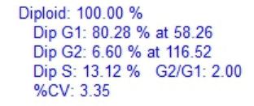
Cell Cycle Analysis
Limitations of one-parametric DNA histograms: Example 2
T47D cells: estrogen dependent breast cancer cell line
Normal serum
Charcoal serum

Slide 11
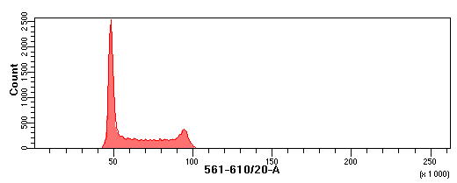
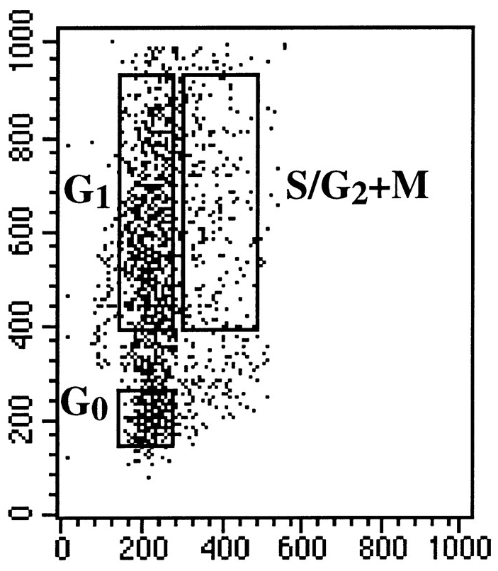
Cell Cycle Analysis
Multiparametric cell cycle analysis: DNA & RNA content
DNA & RNA content analysis in 70 % EtOH fixed/permeabilized cells using Hoechst 33342/Pyronin Y double staining
Impossible to distinguish between G0 and G1, G2 and M phases
Pyronin Y (RNA)
Hoechst 33342 (DNA)
Proliferating cells usually contain higher levels of RNA compared to resting/quiescent cells.
Discrimination G0 and G1 cell populations
using DNA and RNA analysis with Hoechst 33342 and Pyronin Y

Slide 12
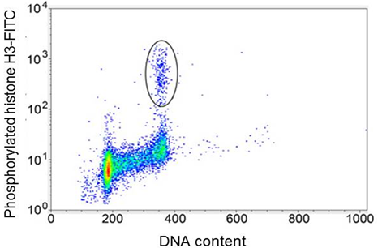
Cell Cycle Analysis
Multiparametric cell cycle and intracellular analysis
DNA content analysis in PFA fixed/0.1% Triton X-100 permeabilized cells using a is cell-impermeant dye (PI, 7-AAD, SYTOX Green, etc.) in combination with labeled anti-cyclin D antibody
Impossible to distinguish between G0 and G1, G2 and M phases
Discrimination G0 and G1 cell populations
The lack of cyclin D and cyclin E expression among the cells with G1 content marks the non-cycling G0 cells

Slide 13
Cell Cycle Analysis
Multiparametric cell cycle and intracellular analysis
DNA content analysis in PFA fixed/0.1% Triton X-100 permeabilized cells using a is cell-impermeant dye (PI, 7-AAD, SYTOX Green, etc.) in combination with anti-phospho-histone H3 antibody
Impossible to distinguish between G0 and G1, G2 and M phases
Discrimination G2 and M cell populations
Histone H3 phosphorylated at Ser-10 appears to be the best marker for mitosis

Slide 14
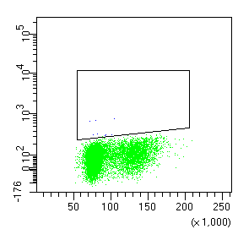
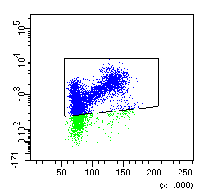
Cell Cycle and Cell Proliferation Analysis
Multiparametric cell cycle and intracellular analysis: Ki-67
DNA content analysis in 70 % EtOH fixed/permeabilized cells using a is cell-impermeant dye (PI, 7-AAD, SYTOX Green, etc.) in combination with labeled anti-Ki-67 antibody
Double staining of Ki-67 and Propidium Iodide
Isotype control
Simultaneous analysis of proliferation specific marker (Ki-67) and cellular DNA content, which discriminate resting/quiescent cell populations (G0 cell) and quantify cell cycle distribution
(G1, S, or G2/M), respectively.
Ki-67
PI
Discrimination G0 and G1 cell populations
Flow cytometric analysis of Ki-67 determines the growth fraction

Slide 15
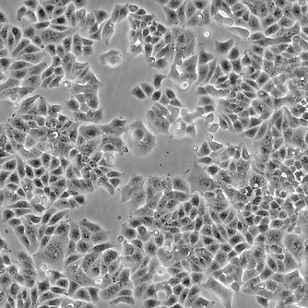
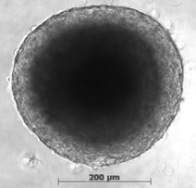
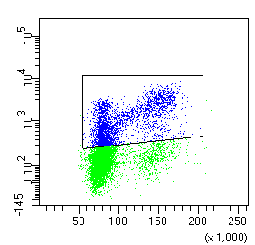
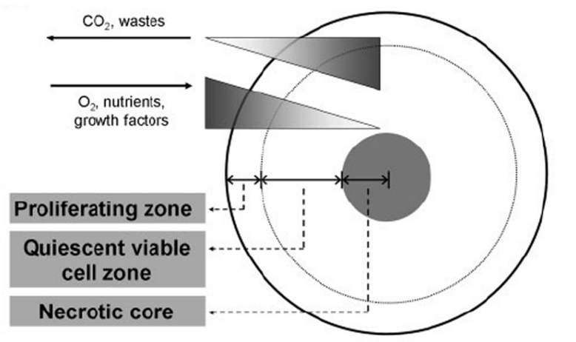
Cell Proliferation
Ki-67 Staining: Assessment of Fraction of Proliferating Cells within the Spheroids and 2D cultures
Spheroids are 3D cell culture models of in vivo solid tumors that are more predictive of drug responses
T47D cells growing in 2D
3D culture of T47D (11 d.)
Isotype control
Isotype control
75.1%
34.6%
75.1%
Ki-67
PI

Slide 16
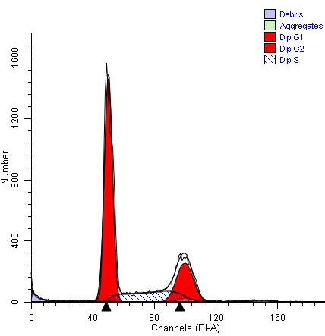
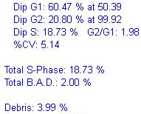
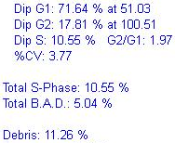
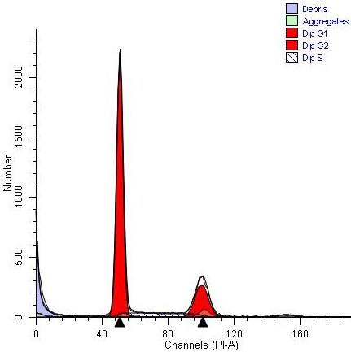
Cell Proliferation
Ki-67 Staining: Assessment of Fraction of Proliferating Cells within the Spheroids and 2D cultures
Spheroids are 3D cell culture models of in vivo solid tumors that are more predictive of drug responses
T47D cells growing in 2D
3D culture of T47D (11 d.)
Isotype control
Isotype control
75.1%
34.6%
75.1%
Ki-67
PI

Slide 17
Cell Proliferation
Ki-67 Staining Combined with Phenotyping
Assessment of Fraction of Proliferating CD3+ and CD19+ Cells after Activation
0.9 % of CD3+
35.8 % of CD3+
CD3+
1.9 % of CD19+
8.2 % of CD19+
CD19+
Ki-67
PBMCs stimulated with anti-CD3/CD28 antibodies, cells analyzed after 3 days of treatment

Slide 18
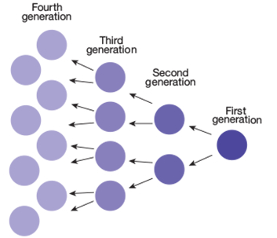
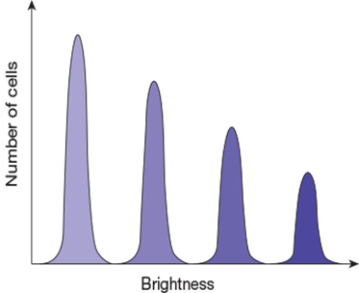
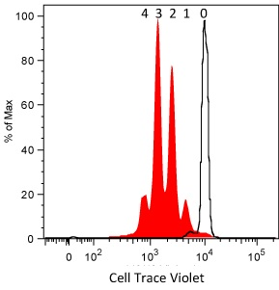
Cell Proliferation
Dye-Dilution Method: Monitoring Cell Proliferation by Generational Tracing
Proliferation Fluorescent Dyes:
CellTraceTM series, PKH26, PKH67, CellVue® Claret, etc.
Bright, non-toxic (titration), readily taken up by the cells, distributed equally between daughter cells
Use the proper controls (unstained, positive control)
Titrate your dye
Collect enough cells to accurately model the data
Exclude apoptotic/dead cells and aggregates from the analysis
As the cell divide,
the dye is diluted out
http://www.thermofisher.com/cz/en/home/references/newsletters-and-journals/bioprobes-journal-of-cell-biology-applications/bioprobes-73/bioprobes-73-cell-proliferation-generational-tracing.html

Slide 19
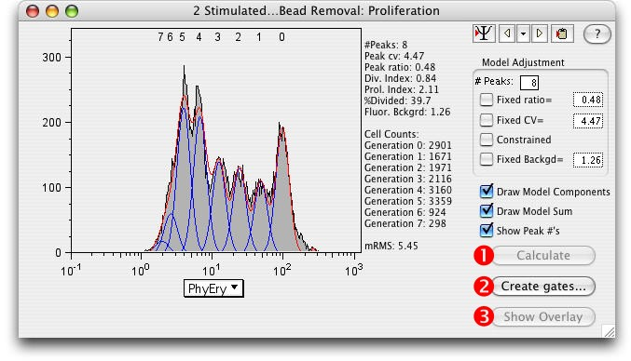
Cell Proliferation
Dye-Dilution Method: Monitoring Cell Proliferation by Generational Tracing
Cells stained and stimulated and/or treated with a test compound
During analysis gated via FSC vs SSC dotplot and “dead cell stain” vs FSC dotplot
CellTrace fluorescence deconvolved by the Proliferation platform in FlowJo
How different cell populations are proliferating based on different stimulation conditions?
- Assay is compatible with immunophenotyping
Division Index?
Proliferation Index?
Some even want to isolate cells after a specific number of cell divisions.

Slide 20
Cell Proliferation
Dye-Dilution Method: Anti-CD3/CD28 and PMA/ionomycin stimulated PBMCs
How different cell populations are proliferating based on stimulation conditions?
Day 0: CellTraceTM Violet staining,
Stimulation of proliferation
Day 3: Phenotyping (anti-CD19 and anti-CD3)
Flow cytometry (Dead cells/aggregates exclusion)
CellTraceTM Violet

Slide 21
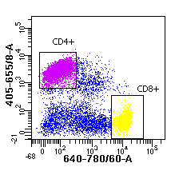
Cell Proliferation
Dye-Dilution Method & Staining of Cell Surface Markers
How different cell populations are proliferating based on stimulation conditions?
Day 0: CellTraceTM Violet staining,
Stimulation of proliferation
Day 6: Phenotyping (anti-CD19, anti-CD4 and-CD8)
Flow cytometry (Dead cells/aggregates exclusion)
Non-stimulated PBMCs
Anti-CD3/CD28 stimulated PBMCs
CellTraceTM Violet

Slide 22
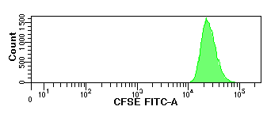
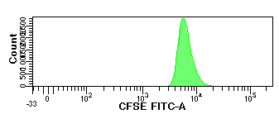
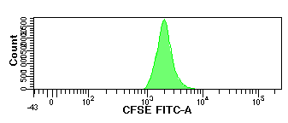
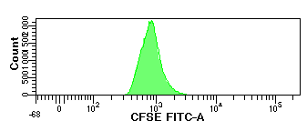
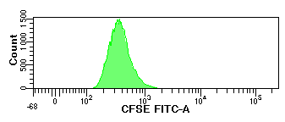
Cell Proliferation
Dye-Dilution Method: Stimulated PBMCs vs. cancer cell line U2OS
Day 0
Day 1
Day 2
Day 3
Day 4

Slide 23
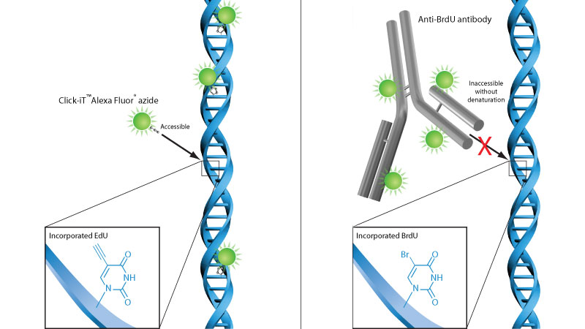
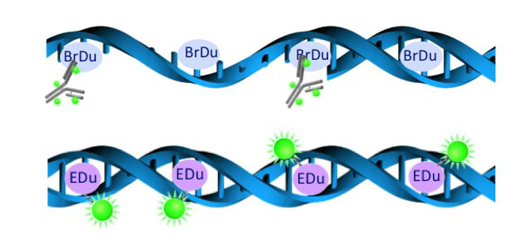
Cell Cycle/Proliferation Analysis
Bromodeoxyurine (BrdU) vs. Click-iT EdU Assay
BrdU and EdU are thymidine analogs
Taken up by cells in S-phase
Usually in combination with PI, 7-AAD or DAPI stains
http://www.lifesci.dundee.ac.uk/technologies/flow-cytometry-cell-sorting/techniques/proliferation

Slide 24
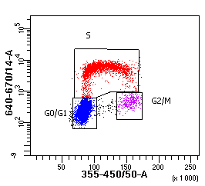
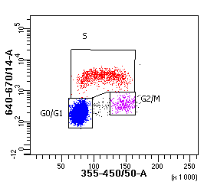
Cell Cycle/Proliferation Analysis
Click-iT EdU Assay
EdU-Cy5
EdU-Cy5
DAPI
DAPI

Slide 25
Apoptosis
Apoptotic Hallmarks for Apoptosis Detection
A decrease in cell size/shrinkage, nuclear condensation, blebbing
Externalisation of the lipid phosphatidyl serine (PS) from the inner to the outer plasma membrane
Disruption of Mitochondrial Membrane Potential
Activation of Caspases
Cleveage of DNA between nucleosomes
Apoptotic bodies and cell debris
„Sub G1“
Apoptotic cells
G1
Apoptotic cells
Live cells
# events
SSC ~ inner complexity
S
G2/M
Propidium iodide
FSC ~ size of the cell
Changes in light scattering properties during apoptosis and assessment of fractional DNA content (sub-G1 fraction)

Slide 26
Apoptosis
Changes in the Plasma Membrane: Annexin V/PI assay
Annexin V FITC⁺ / PI⁻ cells ~ early apoptotic
Annexin V FITC⁺ a PI⁺ cells
~ late apoptotic/dead
Annexin V FITC
PI⁺ ~ fragments of dead cells
Annexin V FITC⁻ / PI⁻
~ live cells
Propidium iodid
Translocation of phosphatidylserine (PS) from the inner of the cell membrane to the outside. It is possible to detect PS by using FITC-labelled Annexin V. By combining staining of Annexin-FITC with propidium iodide, we can obtain a profile, where live cells are negative for both dyes, late apoptotic/dead cells are positive for both, while apoptotic cells are positive only for Annexin-FITC.

Slide 27
Apoptosis
Changes in the Plasma Membrane: Annexin V/PI assay
CCRF-CEM cells
Single cells
control
Annexin V/FITC
5 nM doxourbicin
Annexin V/FITC
Propidium iodide

Slide 28
Apoptosis
Changes in the Plasma Membrane: Annexin V/PI assay
control
Annexin V/FITC
5 nM doxourbicin
Annexin V/FITC
Propidium iodide

Slide 29
Apoptosis
Changes in the Plasma Membrane: Annexin V/PI assay
Tips:
Annexin V binding to PS is reversible, so calcium must be present during the entire assay
Analysis should be carried out quickly after staining
Adherent cells removed by mechanical scraping or trypsin may flip their PS independent of apoptosis
FAN assay: permits to discriminate viable cells from cells undergoing apoptosis even after fixation, can be combined with phenotyping

Slide 30
Apoptosis
Disruption of Mitochondrial Membrane Potential: JC-1 assay
JC-1 dye exhibits potential-dependent accumulation in mitochondria, indicated by a fluorescence emission shift from green to red fluorescence. Mitochondrial depolarization is indicated by a decrease in the red/green fluorescence intensity ratio.
Healthy non-apoptotic cells are detected in both FL1 and FL2 channels and cells with altered mitochondrial function due to apoptosis or other cellular processes remain bright in the FL1 channel, but have reduced FL2 intensity.
https://www.biotek.com/resources/application-notes/fluorescent-detection-of-drug-induced-mitochondrial-toxicity/

Slide 31
Apoptosis
Disruption of Mitochondrial Membrane Potential: JC-1 assay
Positive control (CCCP, FCCP, valinomycin) and compensation required
JC-1 aggregates
(red fluorescence)
CCCP controls should be used to confirm that the JC-1 response is sensitive to changes in membrane potential.
JC-1 monomers (green fluorescence)
SSC
FSC

Slide 32
Apoptosis
Detection of Activated forms of Caspases
CASPASES: A group of cysteine proteases, once activated during apoptosis (initiator caspases-8 and -9) cleave other enzymes (effector caspase-3, caspase-activated DNase) and cytoskeleton ⇒ cell dissasembly
Detection by antibodies that specifically recognize caspase-cleaved fragments (antibodies that recognize the cleaved form of caspase-3, -8, etc)
Flow cytometric analysis of apoptotic and non-apoptotic populations for active caspase-3. Jurkat cells were left untreated (left panel) or treated for 4 hr with camptothecin (right panel) to induce apoptosis. Cells were permeabilized, fixed, and stained for active caspase-3
FITC Active Caspase-3 Apoptosis Kit (BD Biosciences)

Slide 33
Apoptosis
Detection of Activated forms of Caspases
NucView™ 405 Caspase-3 Substrate, 1 mM in DMSO, provides a convenient tool for detecting apoptosis in intact cells based on caspase-3/7 activity using flow cytometry. The staining is formaldehyde-fixable (Biotium Inc.)
CellEventTM Caspase-3/7 Green Detection Kit (ThermoFisher Scientific)
Jurkat cells were treated with DMSO (negative control, blue) or 0.1 uM, 0.25 uM, or 1 uM staurosporine (red) to induce apoptosis
https://biotium.com/product/nucview-530-caspase-3-substrate-1-mm-in-dmso/
Multiplex enabled: can be combined with other fluorescent reagents to confirm apoptosis in the same cell or cell population

Slide 34
Apoptosis
Detection of Activated forms of Caspases
FLICA Caspase Assay detects active caspases inside the cell using Fluorochrome Inhibitor of Caspases (FLICA), cell-permeable and non-cytotoxic caspase inhibitors. FLICA probe covalently binds to activated caspases and then emits fluorescence. Multiplexing possible (propidium iodide, Annexin V staining). FLICAs withstand cell fixation (with 4% PFA) and subsequent cell permeabilization with 70% ethanol or methanol.
https://www.ncbi.nlm.nih.gov/pmc/articles/PMC3863590/figure/F3/

Slide 35
Immunophenotyping
Multicolor Flow Cytometry: Immunophenotyping
Uses labeled antibodies (Abs) to identify cells of interest
Determination of cell surface antigens
Allows for detailed identification of cellular subsets (simultaneously measure multiple parameters cell by cell)
Targets on both cell surface and intracellularly
CD3+
CD19+
CD56+
CD69+ CD25+
CD3+

Slide 36
Immunophenotyping
Multicolor Flow Cytometry: Immunophenotyping
Eliminate the doublets
using a pulse geometry gate
(such as FSC-H x FSC-A)
For markers expressed at low levels use bright fluorochromes (APC, PE, Brilliant Violet™ dyes)
Eliminate both dead cells and debris from your analysis
Apply compensation controls
Include appropriate FMO controls
to identify the proper placement of a gate in a multi-color experiment

Slide 37
Immunophenotyping
Doublet Exclusion
Remove the doublets to avoid:
False positives
Height or Width vs. Area
FSC-H
FSC-W
FSC-A
FSC-A

Slide 38
Immunophenotyping
Dead Cell Discrimination
Remove the dead cells to avoid:
False positives due to autofluorescence
Increased non-specific antibody binding
DNA dyes (PI, 7-AAD, SYTOX stains)
Excluded by live cells
Cannot be used with fixed cells
Dead cells cannot be reliably removed by FSC vs SSC gating
Protein binding (amino-reactive) dyes (Zombie series, BD Horizon™VPD450)
Fixation compatible
Bind both live and dead cells
Then also weak positive samples can be identified!
Zombie NIR
FSC

Slide 39
Immunophenotyping
Immunophenotyping & Apoptosis Detection
Experimental workflow
T cell activation
buffy coats
Ficoll gradient separation
PBMC
Activation with anti-CD3, anti-CD28 and protein G (16 hrs)
Activated T-cells
Galectin-1 / TDG / lactose treatment (2 hrs)
Antibody staining (CD69, CD3)
Flow cytometric analysis of Annexin V⁺ cells
CD69 serves as a marker for the detection of T-cell activation by flow cytometric analysis.
% of apoptotic T-cells

Slide 40
Immunophenotyping
Immunophenotyping & Apoptosis Detection
single cells
CD3+ cells
CD69
CD4
CD3
CD8
5-colour flow cytometric analysis:
CD3+ CD8+cells
CD3 – T lymphocytes (BUV385)
CD8 – cytotoxic T lymphocytes (APC-Cy7)
CD4 – helper T lymphocytes (BV421)
CD69 – early activation marker (PE-CF594)
Annexin V – apoptotic marker (FITC)
Annexin V
CD69

Slide 41
Immunophenotyping
Immunophenotyping & Apoptosis Detection
Galectin-1 + 5 mM TDG (positive control)
Galectin-1 buffer
Galectin-1
2.8 %
21.5 %
7.3 %
Annexin V
Galectin-1 + 5 mM maltose (negative control)
Galectin-1 + 5 mM lactose (positive control)
21.3 %
8.6 %
CD69

Slide 42
Intracellular Analysis
Intracellular Staining
Staining of cell surface only
Easy, fast
No permeabilization required
Low background (for some cell types FcR blocking recommended)
Intracellular staining
Requires fixation and permeabilization
Higher background due to unspecific binding (isotype controls)
Both
Surface staining first, then fixation, permeabilization and intracellular staining

Slide 43
Intracellular Analysis
Fixation
PFA or formaldehyde: used between 0.5% and 4%, crosslinks proteins, samples stable for up to 2 weeks, however must be stored at 4 °C in PBS after initial fixation
70% Ethanol or methanol: fix & permeabilize, precipitate proteins (may hide the epitope), samples stable for months at -20 °C
Tips:
Use cold fixatives
Gentle mixing helps to avoid clumping
Fixation may alter cell size and higher centrifugation speed may be needed

Slide 44
Intracellular Analysis
Permeabilization
Detergent: chose the most appropriate method depending on protein target (consider its subcellular localization, size), used fluorophores (PE and APC are large proteins) - Saponin*, Digitonin, Triton X-100
Ethanol or methanol: fix & permeabilize (dissolves lipids), similarly to some antigens, protein fluorophores (APC, PE, PerCP, etc.) may also be EtOH fixation sensitive
Commercial reagents for both fixation & permeabilization available, work well in most cases (BD Cytofix/Cytoperm™)
* May need to be included throughout the protocol including the washing steps

Slide 45
Intracellular Analysis
Intracellular Cytokine Staining (ICS) Assays
Brefeldin A
(16 h)
LPS, Brefeldin A
(16 h)

Slide 46
Applications of Flow Cytometry
Acknowledgements
Alena Keprová
Alžběta Magdolenová
Jana Günterová
Thank you for your attention
Q & A

