Slide 1
IOCB Prague – General Slides
www.uochb.cz

Slide 2
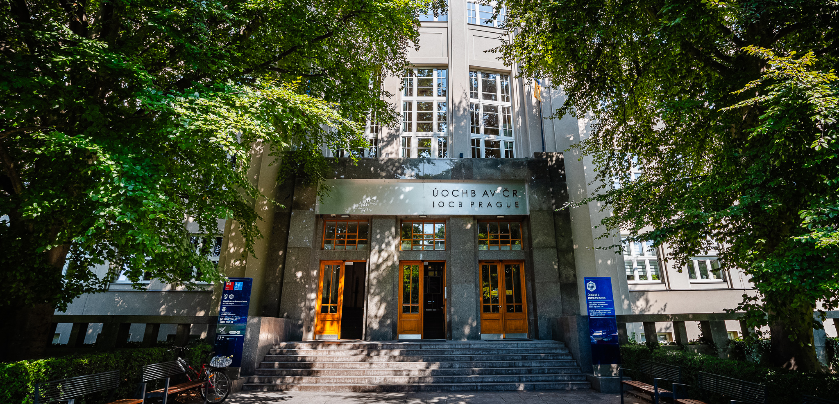
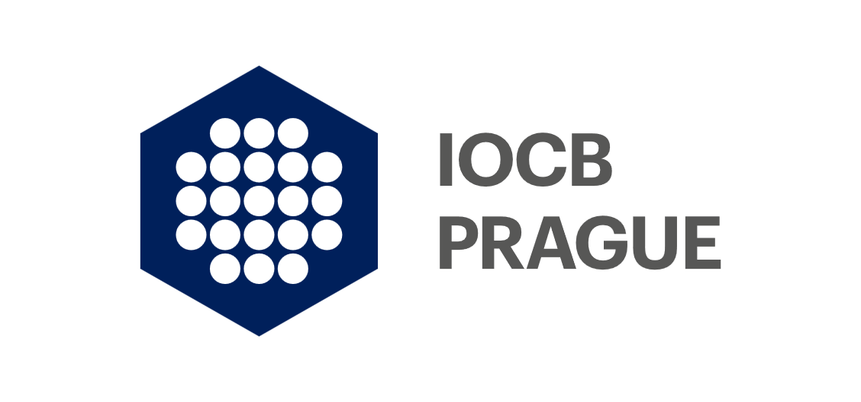
Institute of Organic Chemistry and Biochemistry of the Czech Academy of Sciences

Slide 3
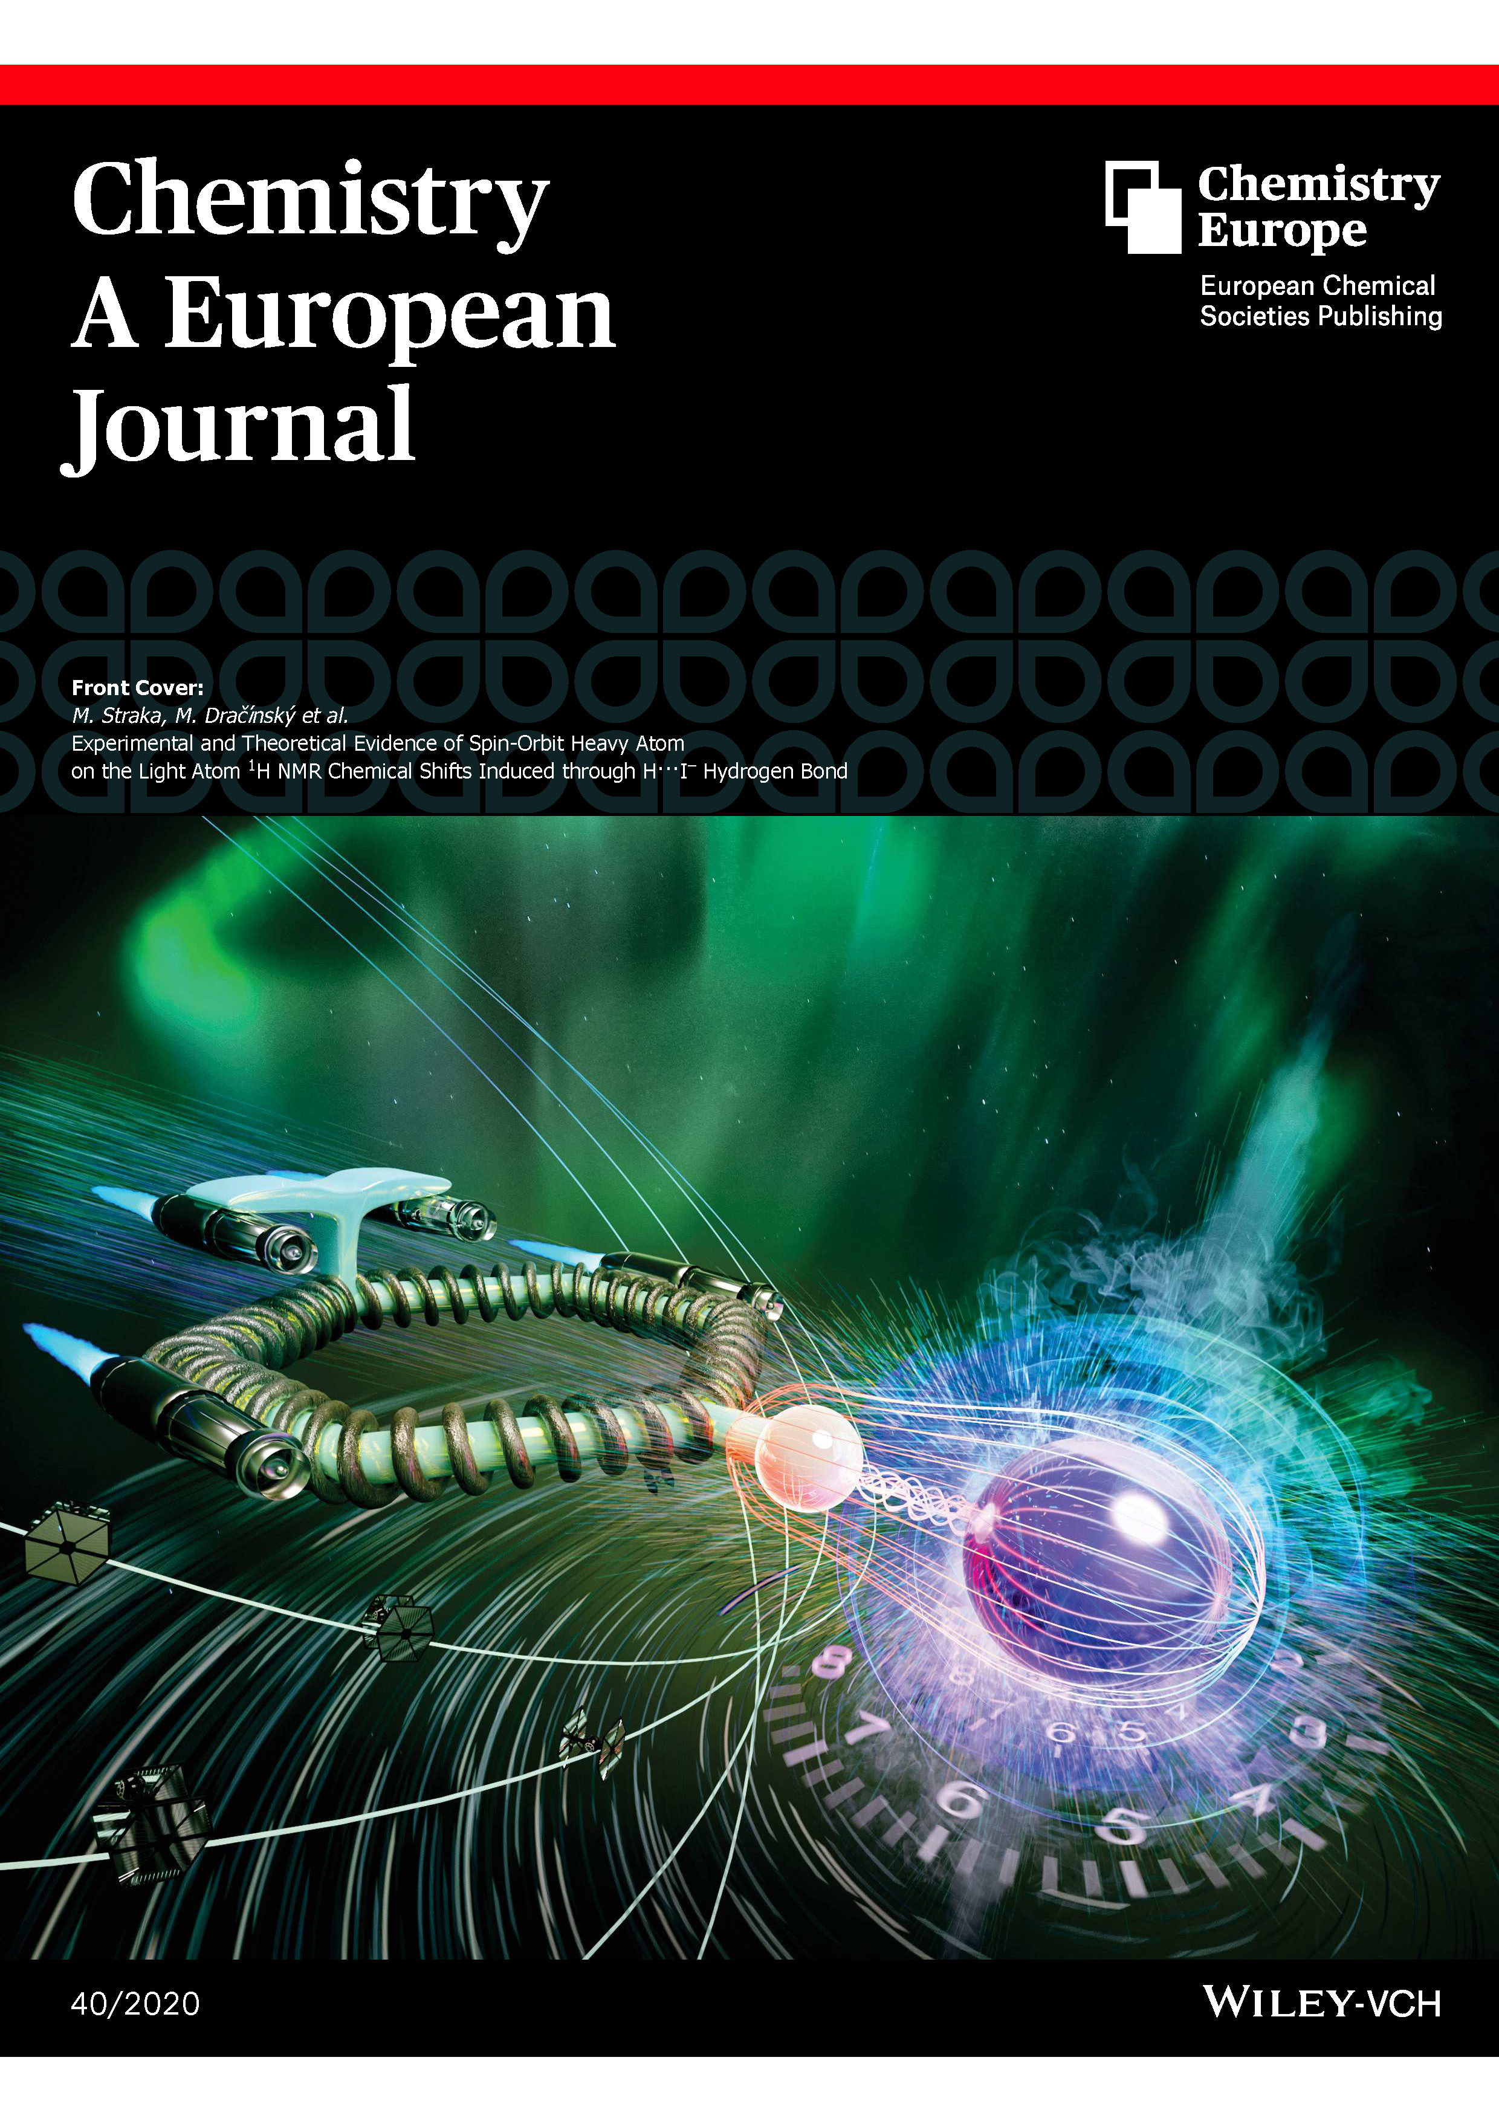
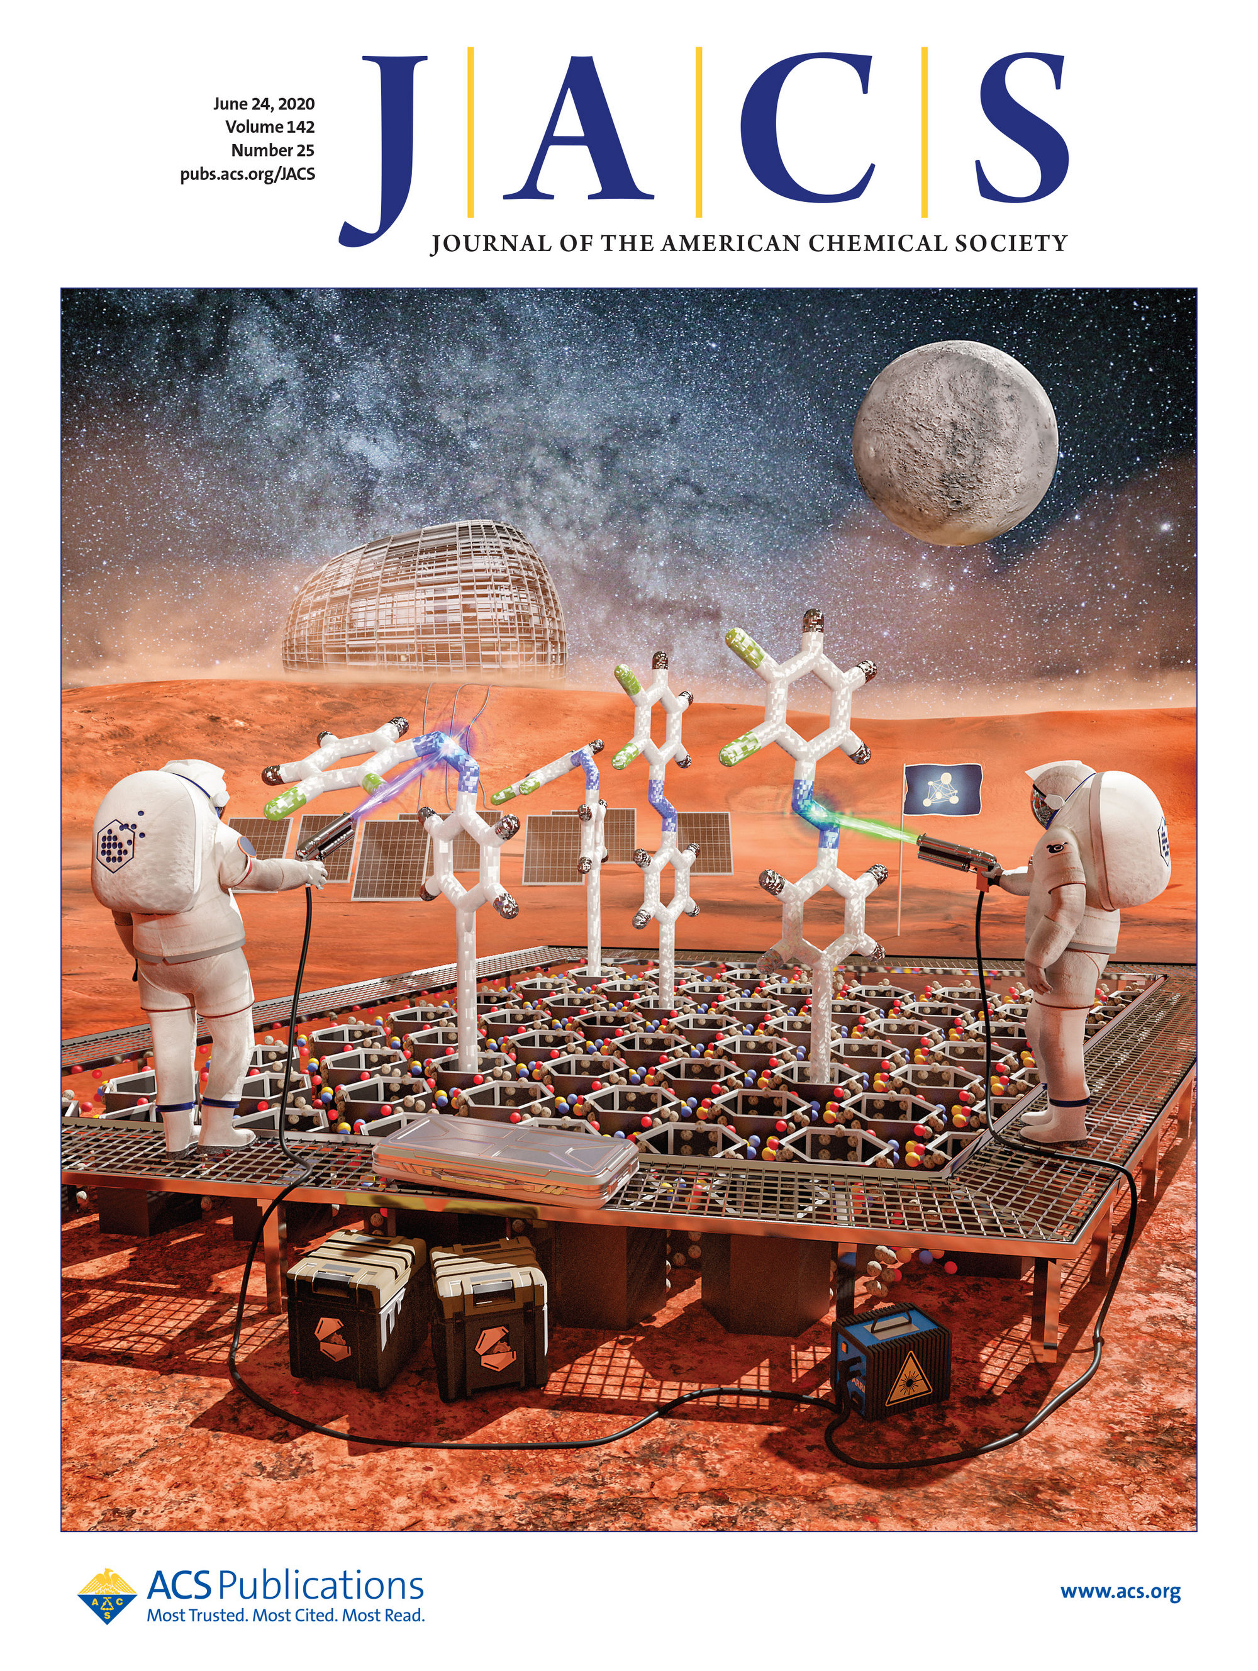
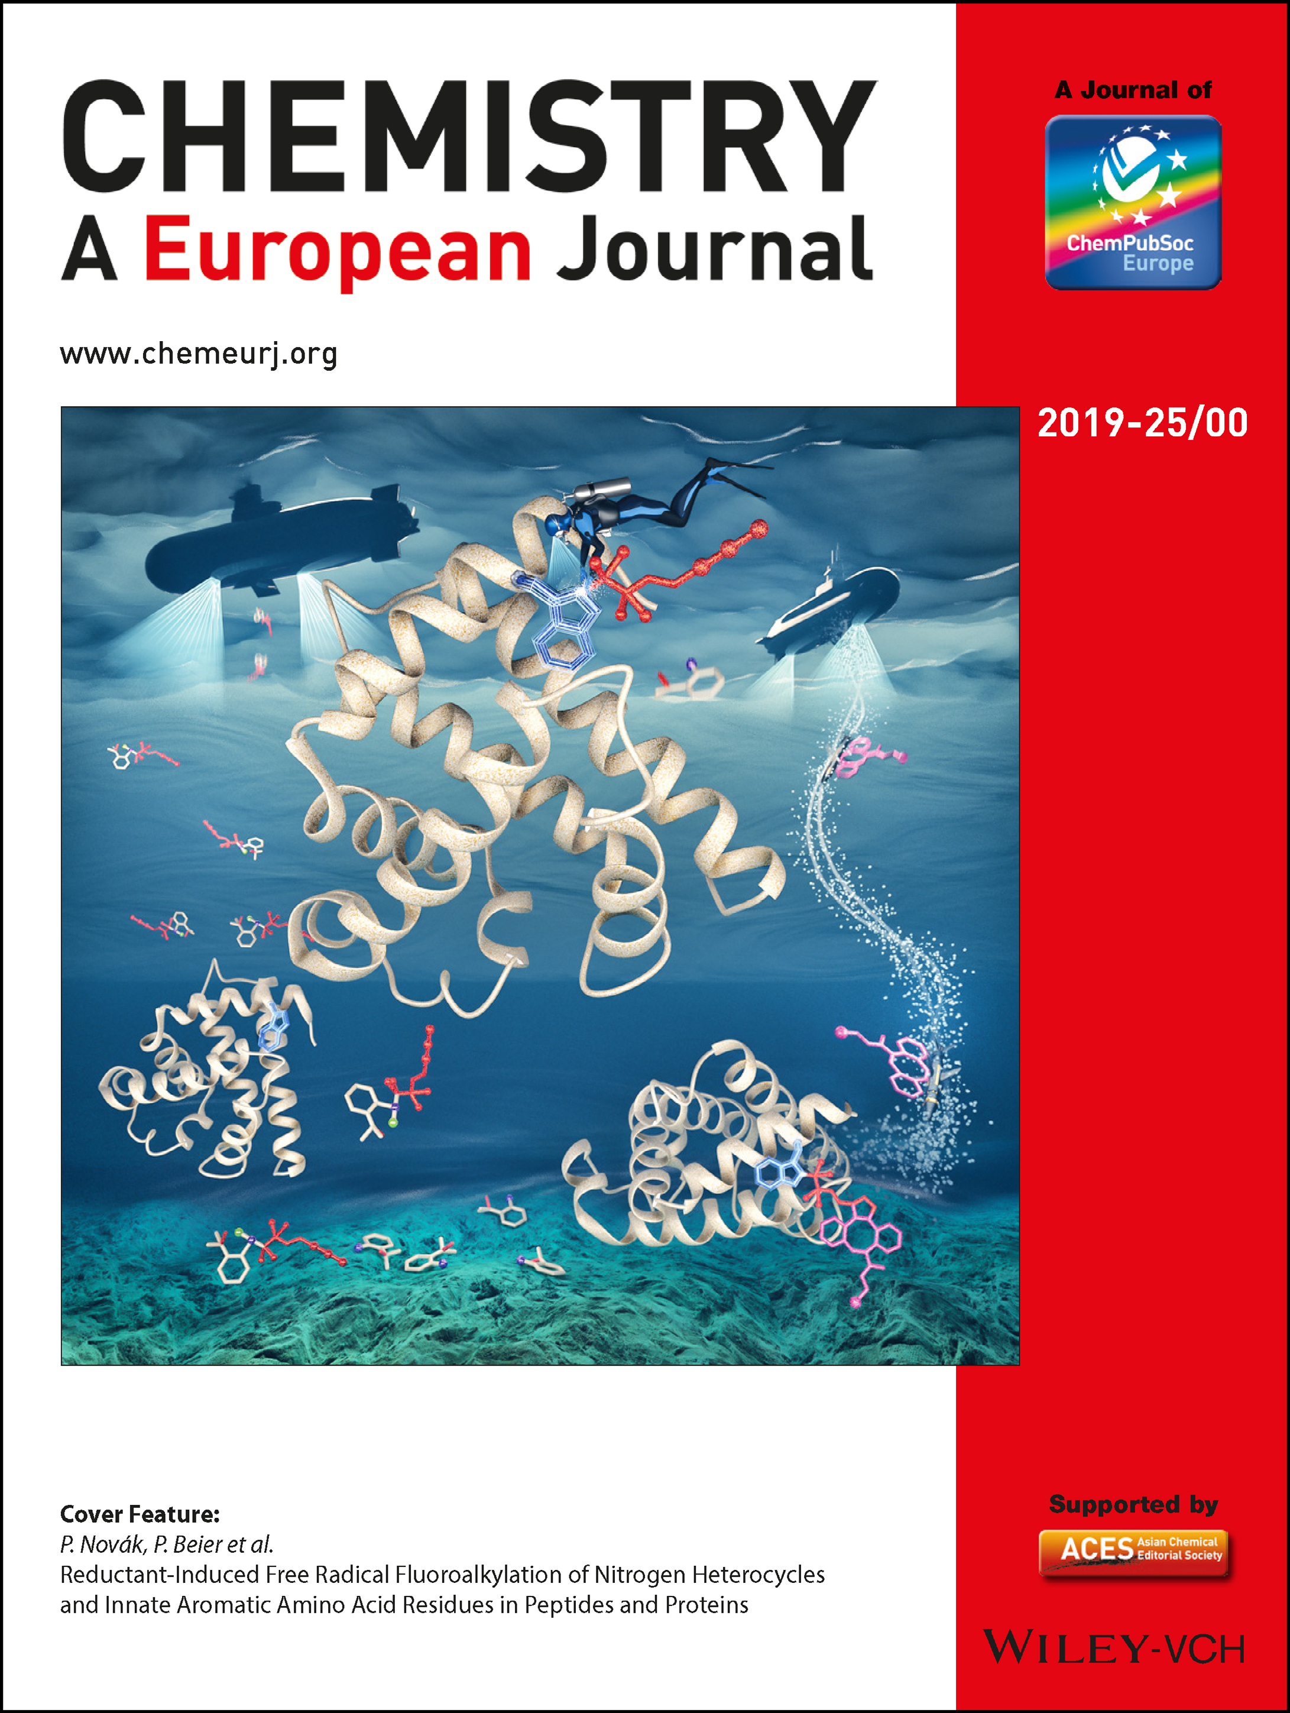
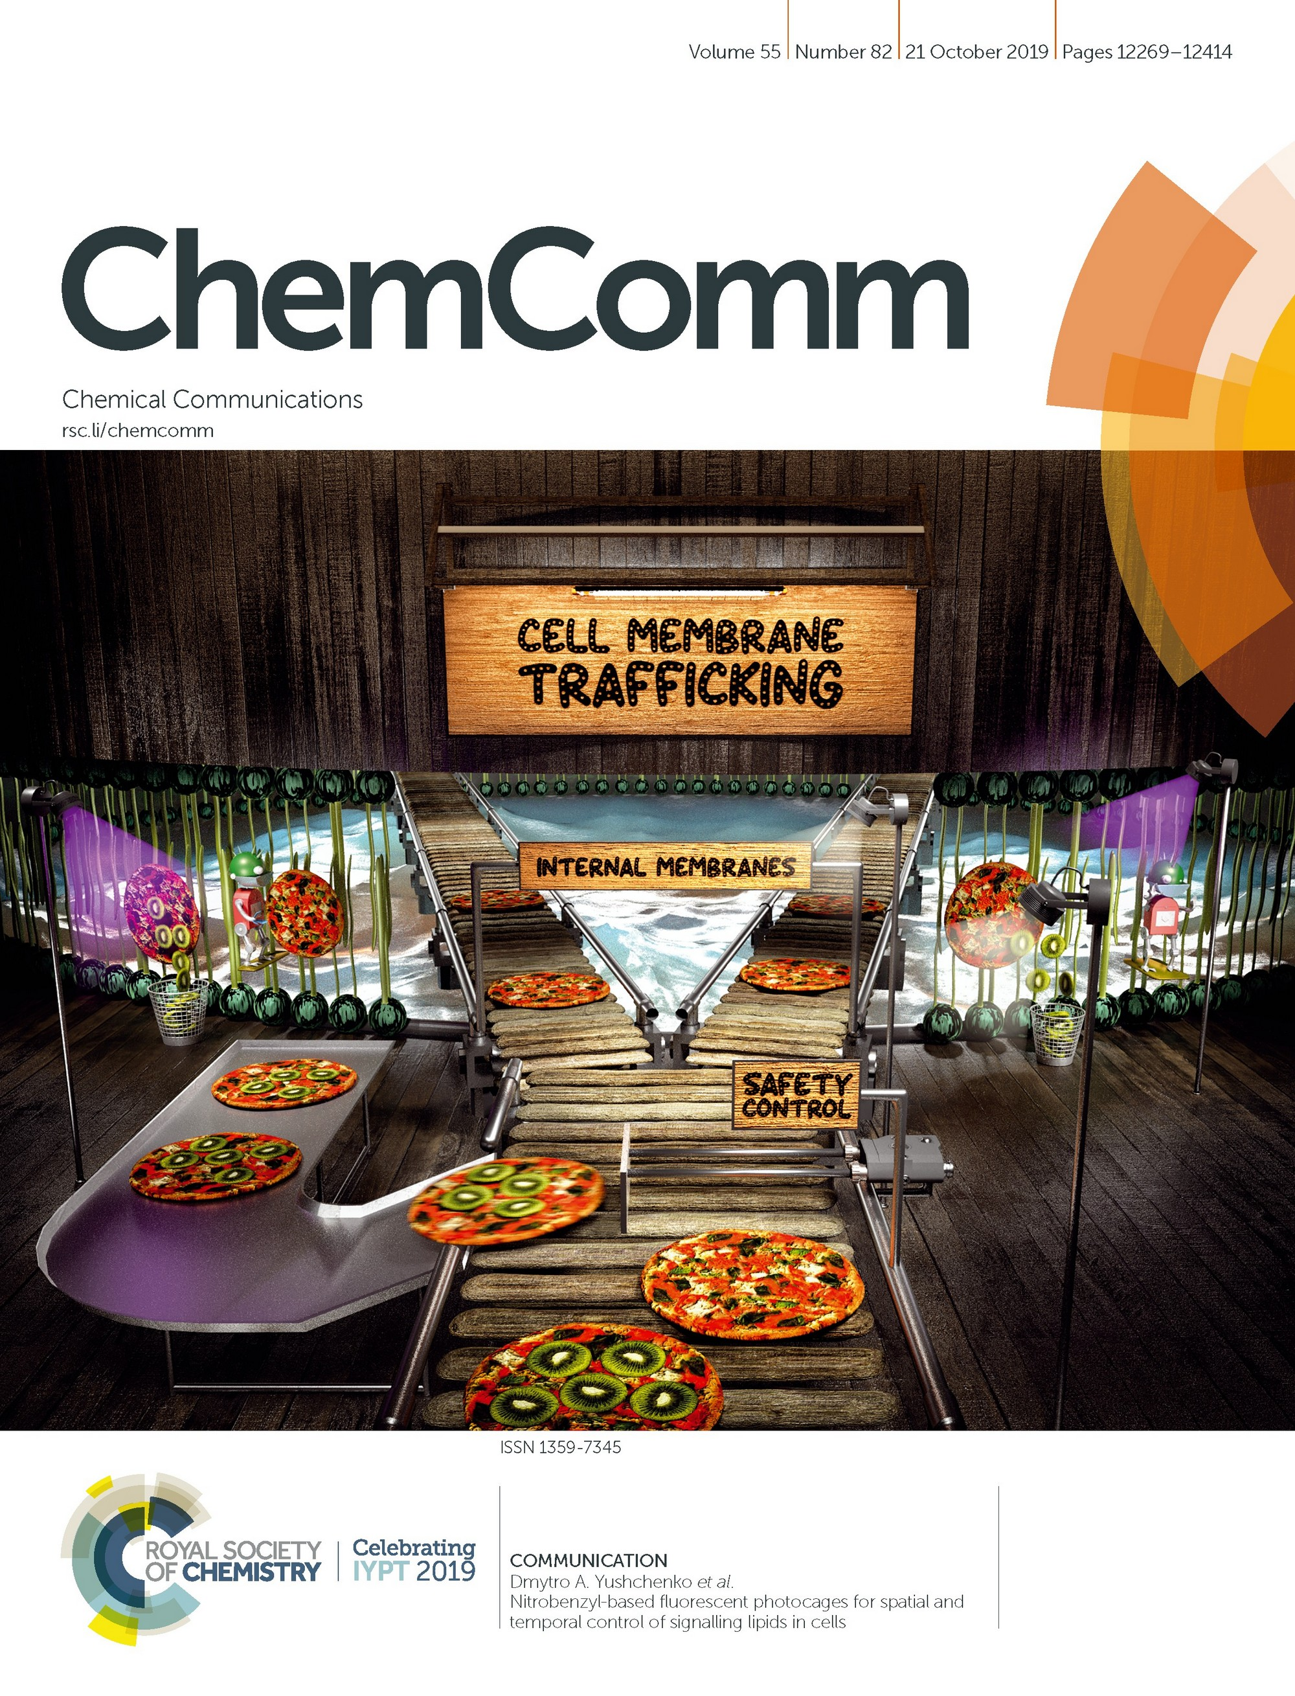
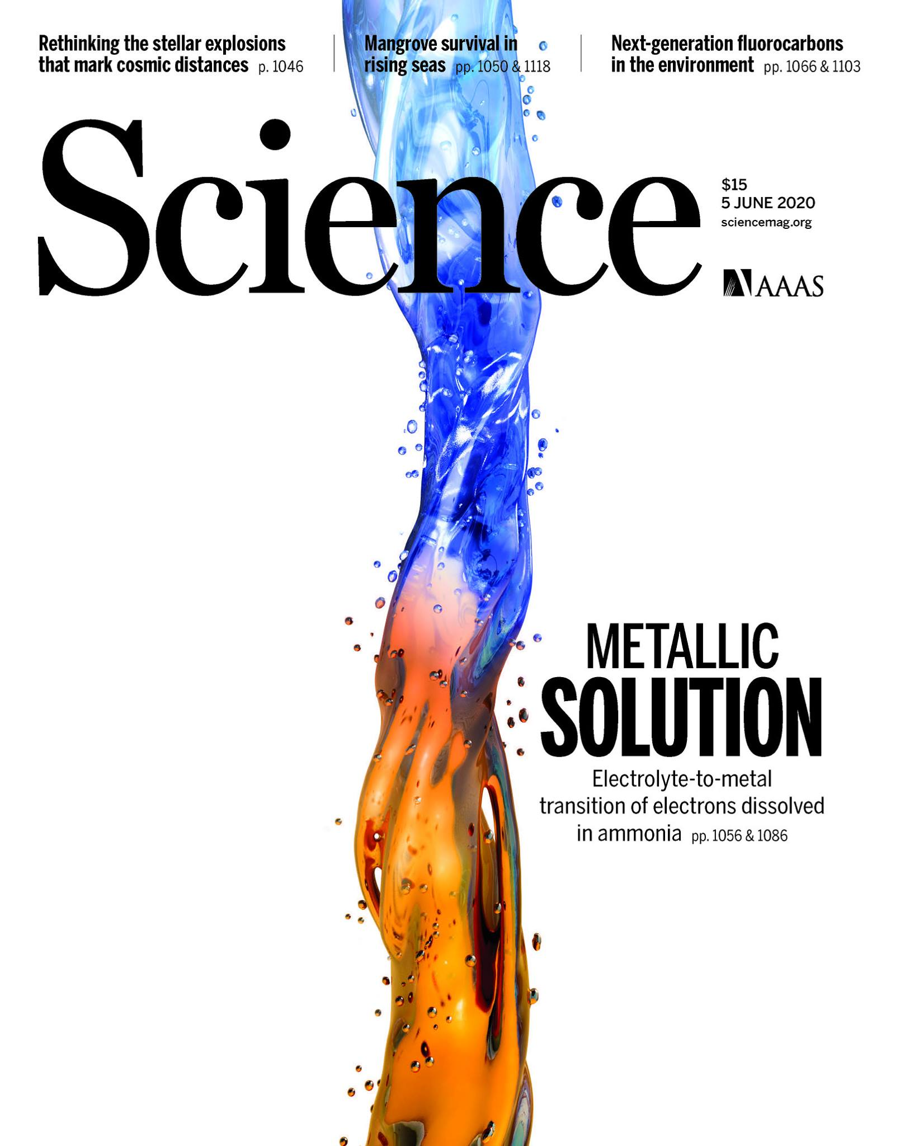
IOCB Prague
leading scientific institution in the Czech Republic
excellent basic research & successful applications at the interface of chemical and biological sciences
emphasis on interdisciplinary approach
particularly successful in medicinal chemistry, chemistry of natural products, organic synthesis and molecular modeling
49 scientific groups, 290 publications/year
800+ employees, 190+ PhD students
international environment, 30+ nationalities
cutting-edge facilities & technologies
collaboration with strong research & commercial partners
www.uochb.cz

Slide 4
IOCB Prague – the past and the present
founded in 1953 by František Šorm as an interdisciplinary institute at the interface of chemistry and biology
excellence in basic research, successful also in applied research, particularly in medicinal chemistry: the most significant contributions were the acyclic nucleotide phosphonate antivirals discovered by Antonín Holý at IOCB and later developed by Gilead Sciences (USA)
In 2007 IOCB transformed into a public research institution
income from patent royalties enabled IOCB to grow and convert its campus into a modern institute with a cutting-edge equipment
all group leader positions open to international competition
rigorous regular evaluations of the research groups by an international advisory board and a tenure-track program for independent junior research groups
www.uochb.cz

Slide 5
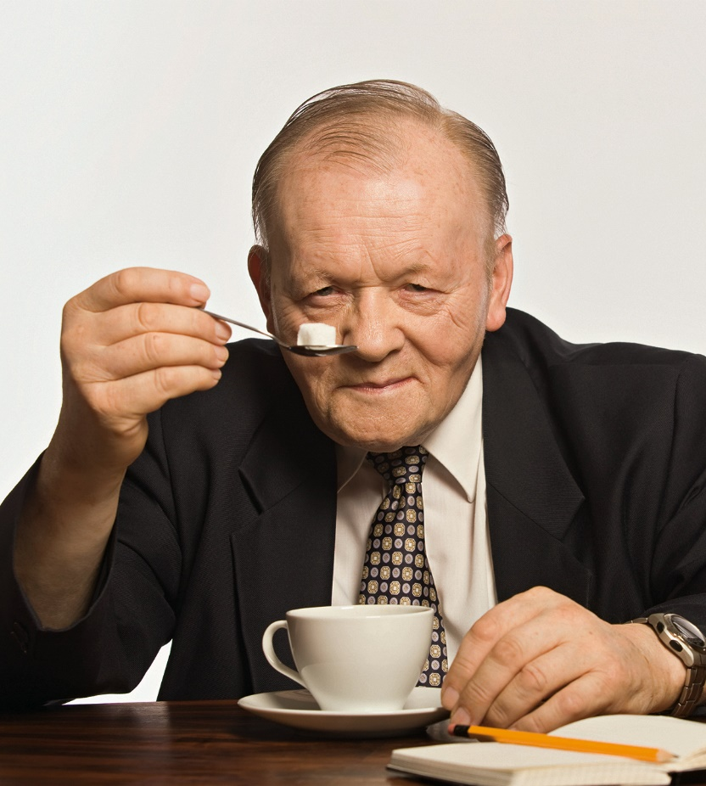
Antonín Holý (1936–2012)
the most successful scientist in the history of IOCB
groundbreaking basic research in the synthetic and medicinal chemistry of modified nucleosides and nucleotides
discovery of clinically used antivirotics
since 1976, collaboration with Erik De Clercq (Rega Institute at the Catholic University of Leuven, Belgium) and John C. Martin (Gilead Sciences)
antivirals based on ANPs (especially tenofovir as a component of Truvada, Atripla, and other anti-HIV and anti-HBV drugs) saved millions of lives worldwide
A. Holý’s legacy in the chemistry of nucleic acid components is alive and prospers in several IOCB groups. Other focus on different approaches to tackle cancer and diseases of viral, bacterial, and fungal origin
Photo: Herbert Slavík
www.uochb.cz

Slide 6
Research at IOCB Prague
CHEM
PHYS
BIO
drug discovery
organic synthesis
medicinal chemistry
natural products chemistry
materials chemistry
chemical biology
photochemistry
nanochemistry
drug design
molecular modeling
computational chemistry
quantum mechanics chemistry
molecular spectroscopy
analytical chemistry
separation science
biochemistry
structural biology
molecular biology
physiology
cell biology
chemical ecology
diagnostic tools
neuroscience
Crosstalk between chemistry and other sciences
Interdisciplinary approach
www.uochb.cz

Slide 7
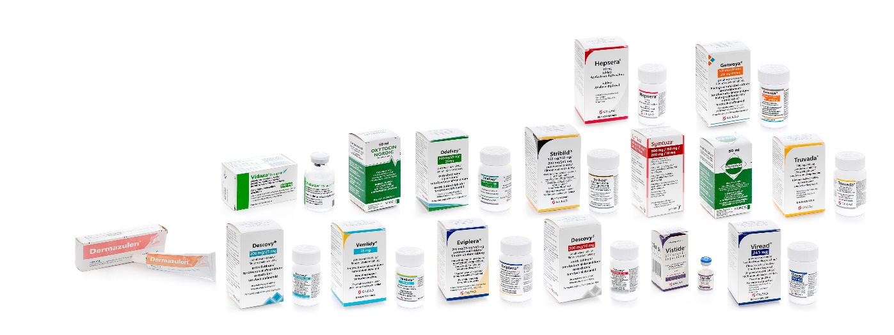
Helping people (and animals) live better lives
Tradition and expertise in drug development together with pharma industry
Antivirotics
dihydroxypropyladenine (Duvira® – Spofa, Léčiva, Zentiva)
cidofovir (Vistide® – Gilead Sciences)
adefovir (Hepsera® – Gilead Sciences)
tenofovir (Viread®, Truvada®, Atripla®, Complera®/Eviplera®, Stribild®, Genvoya®, Odefsey®, Descovy®, Vemlidy®, Biktarvy® – Gilead Sciences; Symtuza® – Janssen Pharmaceutical)
Hormone Analogues
oxytocin (Léčiva, Ferring)
carbetocin (Duratocin® – Léčiva, Ferring, Polypeptide Laboratories; Depotocin® [vet.] – Nordic Pharma)
desmopressin (Adiuretin-SD®/Minirin® – Léčiva, Ferring, Polypeptide Laboratories)
terlipressin (Remestyp®/Glypressin® – Léčiva, Ferring)
Cancerostatics
decitabine (Dacogen® – MGI Pharma, Otsuka America Pharmaceutical)
azacitidine (Vidaza® – Pharmion Corp., Celgene)
rabacfosadine (Tanovea-CA1® [vet.] – VetDC)
Dermatologics
guaiazulene (Dermazulen® – Spofa, Zentiva)
www.uochb.cz

Slide 8
Registered drugs with active substances originating from IOCB Prague
www.uochb.cz

Slide 9
Drugs of Antonín Holý and Alois Pískala
Adefovir, cidofovir and tenofovir (in collaboration with Erik De Clercq from KU Leuven)
Patented and licensed to Gilead Sciences (John Martin) in 1990
Antivirotics for treatment of HIV infection, hepatitis B and other viral diseases
Majority of patent income for Antonín Holý and IOCB Prague, established long-term partnership between IOCB and Gilead Sciences
Awarded with multiple prizes and awards, received recognition and media attention
5-azacytidine (Vidaza); 5-aza-2'-deoxycytidine /decitabine (Dacogen)
Patented and published by IOCB in mid-sixties; it took another 40 years to get them to the market
Orphan drugs thanks to Peter Jones – long after original patents expired
cytostatics in treatment of acute myeloid leukemia and myelodysplastic syndrome – epigenetic therapy
No income or fame from the patents
Partial acknowledgement from IOCB just before his passing
www.uochb.cz

Slide 10
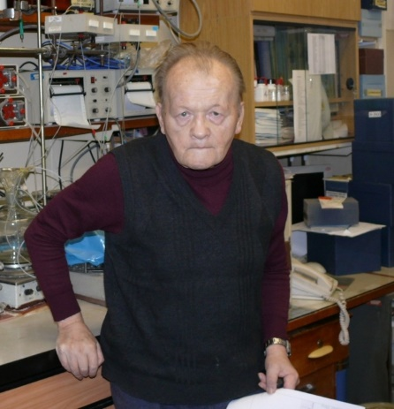
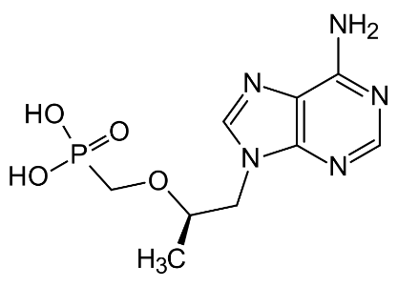
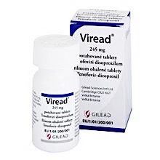
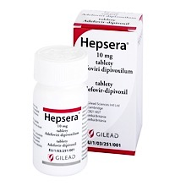
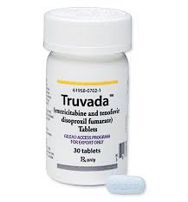
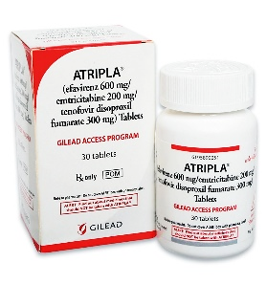
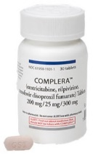
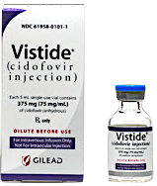
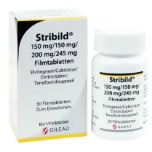
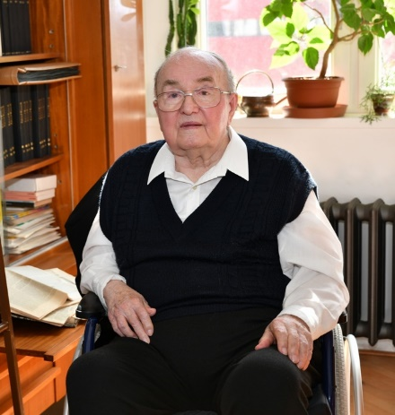
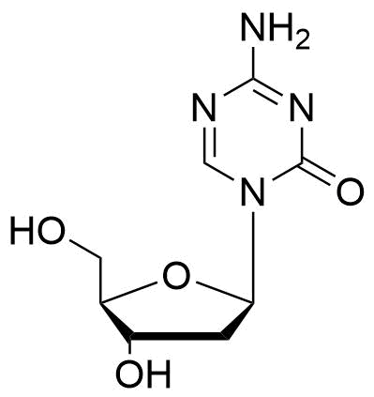
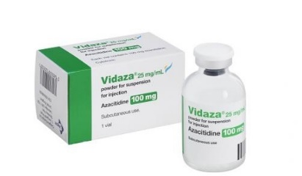
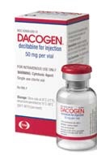
Compounds of A. Holý and A. Pískala
Antonín Holý
Tenofovir
Cidofovir
Adefovir
Alois Pískala
Azacitidine
Decitabine
www.uochb.cz

Slide 11
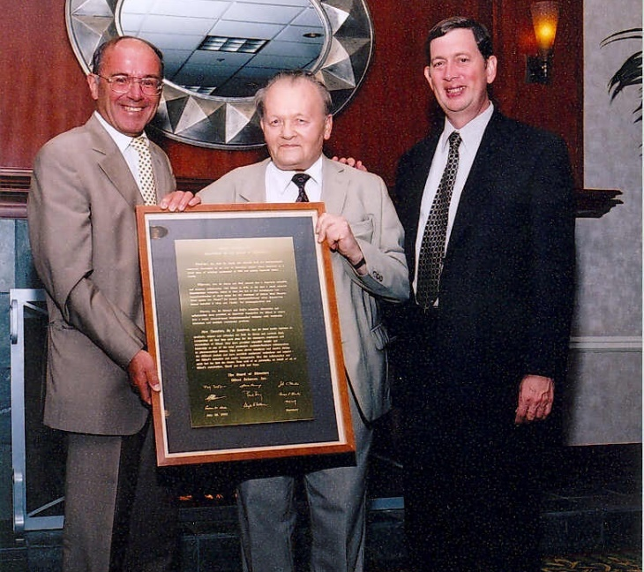
Acyclic nucleoside phosphonates (ANPs)
Key partnership: “Holý” Trinity
Drug Development
Gilead Sciences Foster City, USA
John Martin
Synthesis
IOCB Prague
Prague
Czechia
Antonín Holý
Virology
Rega Institute KU Leuven
Belgium
Erik De Clercq
www.uochb.cz

Slide 12
PhD program at IOCB Prague
IOCB Prague is looking for talented, independent, and highly motivated PhD students with an MSc degree or equivalent in life sciences or related fields
► www.uochb.cz/phd
www.uochb.cz

Slide 13
Postdoc positions at IOCB Prague
IOCB has a lot to offer
110+ young researchers in our growing community of IOCB postdocs
40 % of them are international
fellowships for postdocs available
► www.uochb.cz/en/open-positions
www.uochb.cz

Slide 14
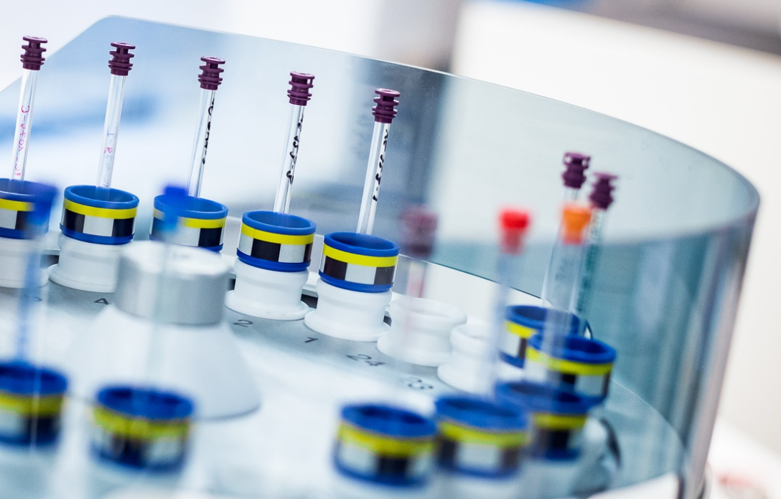
Institute of Organic Chemistry and Biochemistry of the Czech Academy of Sciences
Flemingovo náměstí 542/2 166 10 Praha 6 Czech Republic
Discover more
www.uochb.cz
IOCBPrague

