Slide 1
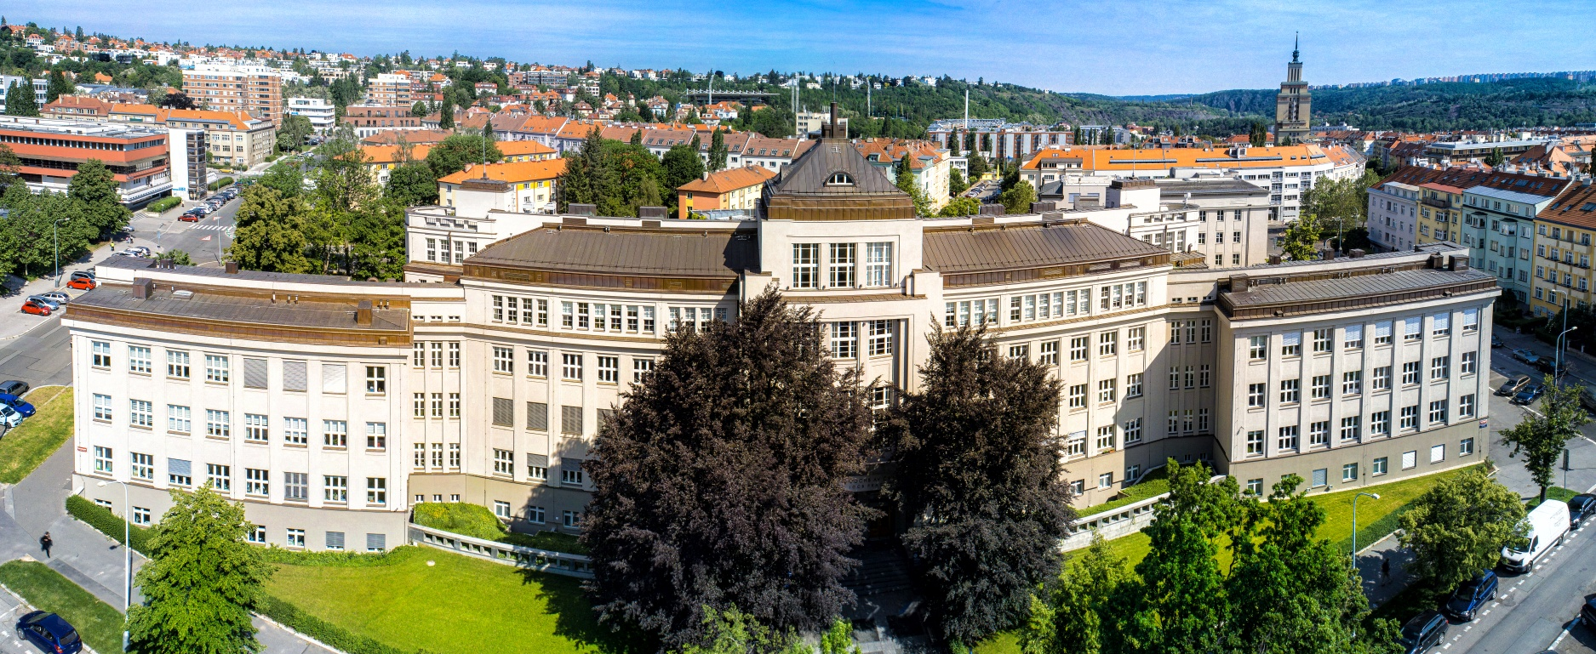
IOCB Prague
1 000+ employees | 49 scientific groups | 220+ PhD students
Excellent basic research & successful applications (eg. HIV/HBV antivirals), particularly in medicinal chemistry, chemistry of natural products, molecular modeling
Patent royalties enabled IOCB to convert into a modern institute with a cutting-edge equipment
Collaboration with strong research & commercial partners
Looking for talented, ambitious
and motivated colleagues
Modern campus near the historical city center
Employee contract & benefits
International community
Support for parents with small children
www.uochb.cz/phd
www.uochb.cz/postdoc
IOCBPrague

